Slide 1
Cisco Unified Computing System (UCS) -Changing the Economics of the Datacenter
October 2017

Slide 2
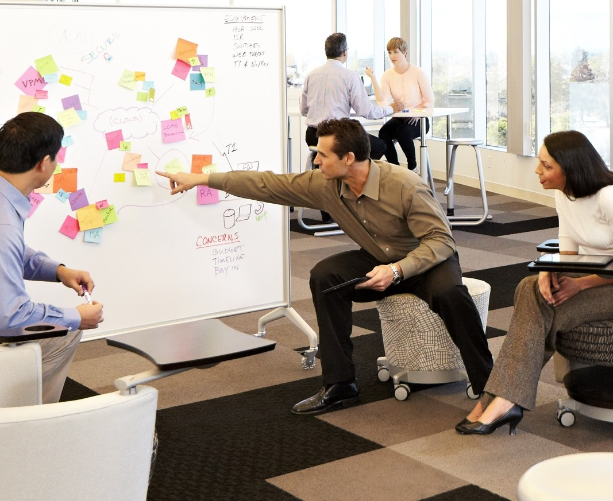
Agenda
Connecting UCS technology innovations to TCO improvement
Real world customer results
Notes:
Many of you are dealing with stagnant to declining IT budgets.
Being asked to do more with the same or less.
How do you choose a server vendor? What impact will that choice have on your budget?
Having worked on hundreds of TCO analysis on Cisco UCS and reading even more customer case studies, I have some ideas.
We will be discussing UCS and its impact on CapEx and OpEx, breaking down the categories of savings.
If you are expecting a deep dive on UCS, you’re in the wrong place. I’ll be explaining the technologies a bit, but this is about their impact on costs.
To quote, Jerry Maguire, I’ll “show you the money.”

Slide 3
Data center economics
Source: Gartner, Cisco IT, “Data Center Cost Portfolio”
Source: IDC #250082, “Worldwide Server, Power and Cooling, and Management
and Administration Spending 2014–2018 Forecast,” August 2014
Notes:
Let’s take a look at the root causes of this maintenance predicament and some other recent cost trends you might be seeing in your data center.
Today, the data center makes up 44% of overall IT spend. The traditional model of data center investment was to build in silos—often with dedicated resources for lines of business—and to design them for peak environments. Unfortunately, this model had some inherent inefficiencies because resources couldn’t be shared and, for the majority of the time, applications weren’t maximizing the capability of the server platform, which drove up costs via underutilization of resources
A few other things jump out. First, more than 50% of the cost is the combination of people and software, with energy and facilities as the next largest chunk (contributing no new value-add to the IT department—it’s required to simply keep things running). One may come to the conclusion that infrastructure doesn’t matter that much, but when you actually analyze the root cause of the spiraling costs in people and software, one quickly realizes that they are related to the infrastructure – and the software to manage it.
For instance, if we double click on servers, while the cost of hardware has been flat or declining for the past 15 years, the cost of managing and operating servers has been growing steadily OpEx and now represents 2/3 of the total spend associated with servers. The problem has been exacerbated by virtualization because higher server utilization has come at the price of increasing complexity that shows in the rising costs.
Before we do that let’s look at some of the trends going on within CapEx and OpEx at the bar chart. Note that server and power and cooling costs seem to be remaining steady. Even with the inherent efficiencies of server virtualization—companies continue to need to invest in servers because of the growth in project demand they continue to experience.
But where increase pain is really being felt is in the area of management and administration costs associated with your virtual servers. This stems from the problem of the traditional approach to management in so many IT organizations. Because a wide variety of traditional servers, software systems, storage have been utilized, and implemented in silos—most system management functions are complicated—designed to try to integrate solutions that were never designed to work together. Virtualization, of course, means there is increasing movement of virtual machines—and the need to ensure key information and adequate security moves with them. Without a simpler approach to management, administration costs will continue to escalate.

Slide 4
Cost categories impacted by Cisco UCS
Servers and Warranty
SingleConnect,
Networking, Cabling,
and Warranty
Power and
Cooling
Traditional solution
Provisioning and
Ongoing Administration
Unified Fabric
Radical infrastructure simplification
Efficient scaling
High performance
Systems
Management Software
Unified Management
Embedded device management
Self-integrating
Stateless
Automated
Programmable
UCS solution
Notes:
We can then group these buckets into two categories: Unified Fabric & Unified Management

Slide 5

Provisioning
Ongoing administration
Servers
Provisioning
Infrastructure and cabling
Power and cooling
System management
Real world TCO examples

Slide 6
Provisioning and admin cost reduction
Eliminate manual configuration
UCS Manager Embedded in All System Devices
UCS Manager: Auto-discovery, Self-integrating Components
Automation replaces
repetitive tasks
UCS Service Profiles
Policy-based Management
Extend investment
in existing tools
Seamless Integration with Existing Tools = No Stranded
Systems Management Investments
Extend the reach
of SME’s
UCS Manager and UCS Central Allow Administrators to Scale
Across Larger Installations and Across Data Center/Geos
Notes:
The chevron has the savings, the callout text has the how. The payoff for each chevron is covered on the remaining slides in the section.

Slide 7






Traditional element configuration
LAN
SAN
Subject matter experts consumed by manual configuration chores
Serial processes and multiple touches inhibit provisioning speed
Configuration drift and maintenance challenges
QoS settings
Border port assignment
per vNIC
NIC transmit/receive rate limiting
FC fabric assignments for HBAs
VLAN assignments for NICs
VLAN tagging config for NICs
Number of vHBAs
HBA WWN assignments
FC boot parameters
HBA firmware
Remote KVM IP settings
Call home behavior
Remote KVM firmware
Storage
SME
Server
SME
Network
SME
Server UUID
Serial over LAN settings
Boot order
IPMI settings
BIOS scrub actions
BIOS firmware
BIOS settings
RAID settings
Disk scrub actions
Notes:
Idea is to highlight the complexity of a server configuration.

Slide 8


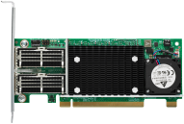
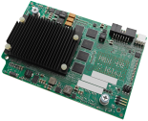
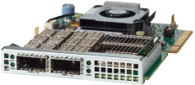


UCS: Bare metal abstraction
Cisco Service Profile
Automated, Policy-based
Configuration of Entire Hardware Stack
Abstraction of bare-metal configuration and server identity
Encapsulated in Cisco
service profiles
Available through an
intuitive GUI, CLI, or XML API
Uplink port configuration, VLAN, VSAN, QoS, and EtherChannel
Server port configuration including LAN and SAN settings
Cisco UCS 6200/6300
Series Fabric Interconnects
Network interface card (NIC) configuration: MAC address, VLAN, and QoS settings; host bus adapter HBA configuration: worldwide names (WWNs), VSANs, and bandwidth constraints; and firmware revisions
Cisco Virtual Interface Cards
Unique user ID (UUID), firmware revisions, and RAID controller settings
Service profile assigned to server, chassis slot, or pool
Cisco UCS B-Series Blade or
C-Series Rack-Mount
Notes:
Cisco is the only truly stateless server
Allows server Z to become server A
Deploying 100 servers is as easy as 1
Ensures consistency and removes errors
Over 127 different server identification and configuration settings
UUID, BIOS, disk, NIC (MAC, VLAN, QoS), HBA (WWID, VSAN), etc.
Applicable to both rack and blade servers
Supported on all server generations
Policies ensure boot order, firmware revisions, etc.

Slide 9




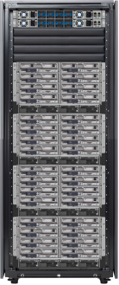
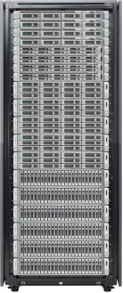
UCS Service Profiles
Configuration portability
Service Profile
Identity for a server
SIM Card
Identity for a phone
UCS Service Profile
Unified Device Management
Network Policy
Storage Policy
Server Policy

Slide 10
Unified, embedded management
1
Subject matter experts
define policies
Storage
SME
Server
SME
Network
SME
Server Policy
Storage Policy
Network Policy
Virtualization Policy
Application Profiles
Notes:
Parallelizes new server installs
Role-based access control allows for domain experts to have control of their pools
Server admins
LAN admins
Storage admins
GUI or command line
Extensible XML API gives you full control and scriptability with a single tool

Slide 11
Unified, embedded management
1
2
Subject matter experts
define policies
Policies used to create service profile templates
Server name
UUID, MAC, WWN
Boot information
LAN, SAN config
Firmware policy
Storage
SME
Server
SME
Network
SME
Server Policy
Storage Policy
Network Policy
Virtualization Policy
Application Profiles
Notes:
Parallelizes new server installs
Role-based access control allows for domain experts to have control of their pools
Server admins
LAN admins
Storage admins
GUI or command line
Extensible XML API gives you full control and scriptability with a single tool

Slide 12




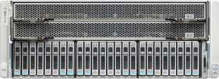
Unified, embedded management
1
2
3
4
Subject matter experts
define policies
Policies used to create service profile templates
Service profile templates create service profiles
Associates service profiles with hardware configures servers automatically
Server name
UUID, MAC, WWN
Boot information
LAN, SAN config
Firmware policy
Server name
UUID, MAC, WWN
Boot information
LAN, SAN config
Firmware policy
Storage
SME
Server
SME
Network
SME
Server name
UUID, MAC, WWN
Boot information
LAN, SAN config
Firmware policy
Server Policy
Server name
UUID, MAC, WWN
Boot information
LAN, SAN config
Firmware policy
Storage Policy
Network Policy
Virtualization Policy
Server name
UUID, MAC, WWN
Boot information
LAN, SAN config
Firmware policy
Application Profiles
Notes:
Parallelizes new server installs
Role-based access control allows for domain experts to have control of their pools
Server admins
LAN admins
Storage admins
GUI or command line
Extensible XML API gives you full control and scriptability with a single tool

Slide 13

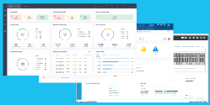




UCS Configuration
Open programmatic interfaces
APIs
Cisco UCS management
Policies
Policies
Policies
Infrastructure pools
Templates with consistent scaling
Security, redundancy, and Role-Based Access Control (RBAC)
Notes:
Cisco is the only truly stateless server
Allows server Z to become server A
Deploying 100 servers is as easy as 1
Ensures consistency and removes errors
Over 127 different server identification and configuration settings
UUID, BIOS, disk, NIC (MAC, VLAN, QoS), HBA (WWID, VSAN), etc.
Applicable to both rack and blade servers
Supported on all server generations
Policies ensure boot order, firmware revisions, etc.

Slide 14



Average 83% reduction in provisioning times
Based on 115 customer case studies
Able to deploy new servers quicker, from two weeks to three
or four hours.
… server deployment time has been reduced by between 80 and 90 percent, which means IT staff can focus more on mission critical or value added tasks.
Evangelisches Krankenhaus Königin Elisabeth Herzberge.
CEIA has seen an almost 100 percent improvement in server deployment times, along with a 50 percent increase in server efficiency.
Notes:
Examples from published case studies. Main repository for case studies - http://www.cisco.com/en/US/solutions/ns340/ns517/ns224/dc_case_studies.html
Cegal - http://www.cisco.com/c/dam/en/us/products/collateral/servers-unified-computing/ucs-b200-m4-blade-server/cegal-voc-case-study.pdf
Evangelisches Krankenhaus Königin Elisabeth Herzberge - http://www.cisco.com/en/US/solutions/collateral/ns340/ns517/ns224/keh_v2cs_external_casestudy_fnl_05_08_13.pdf
Costruzioni Elettroniche Industriali Automatismi (CEIA) - http://www.cisco.com/en/US/solutions/collateral/ns340/ns517/ns224/ceai_v2cs_final_6_21_13.pdf

Slide 15
Provisioning
Ongoing administration
Servers
Ongoing administration
Infrastructure and cabling
Power and cooling
System management
Real world TCO examples

Slide 16
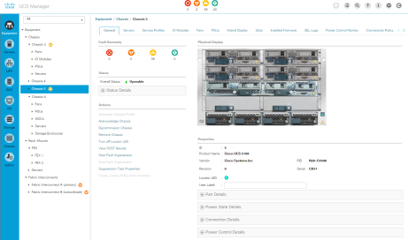
System management – UCS Manager
UCS Manager for
a Single Domain
Notes:
160 Blade & Rack Servers and Access Layer Networking
UCS Manager/UCS Central does:
Provisioning
Configuration changes
Inventory
Diagnostics
Monitoring, fault detection
Auditing, statistic collection

Slide 17
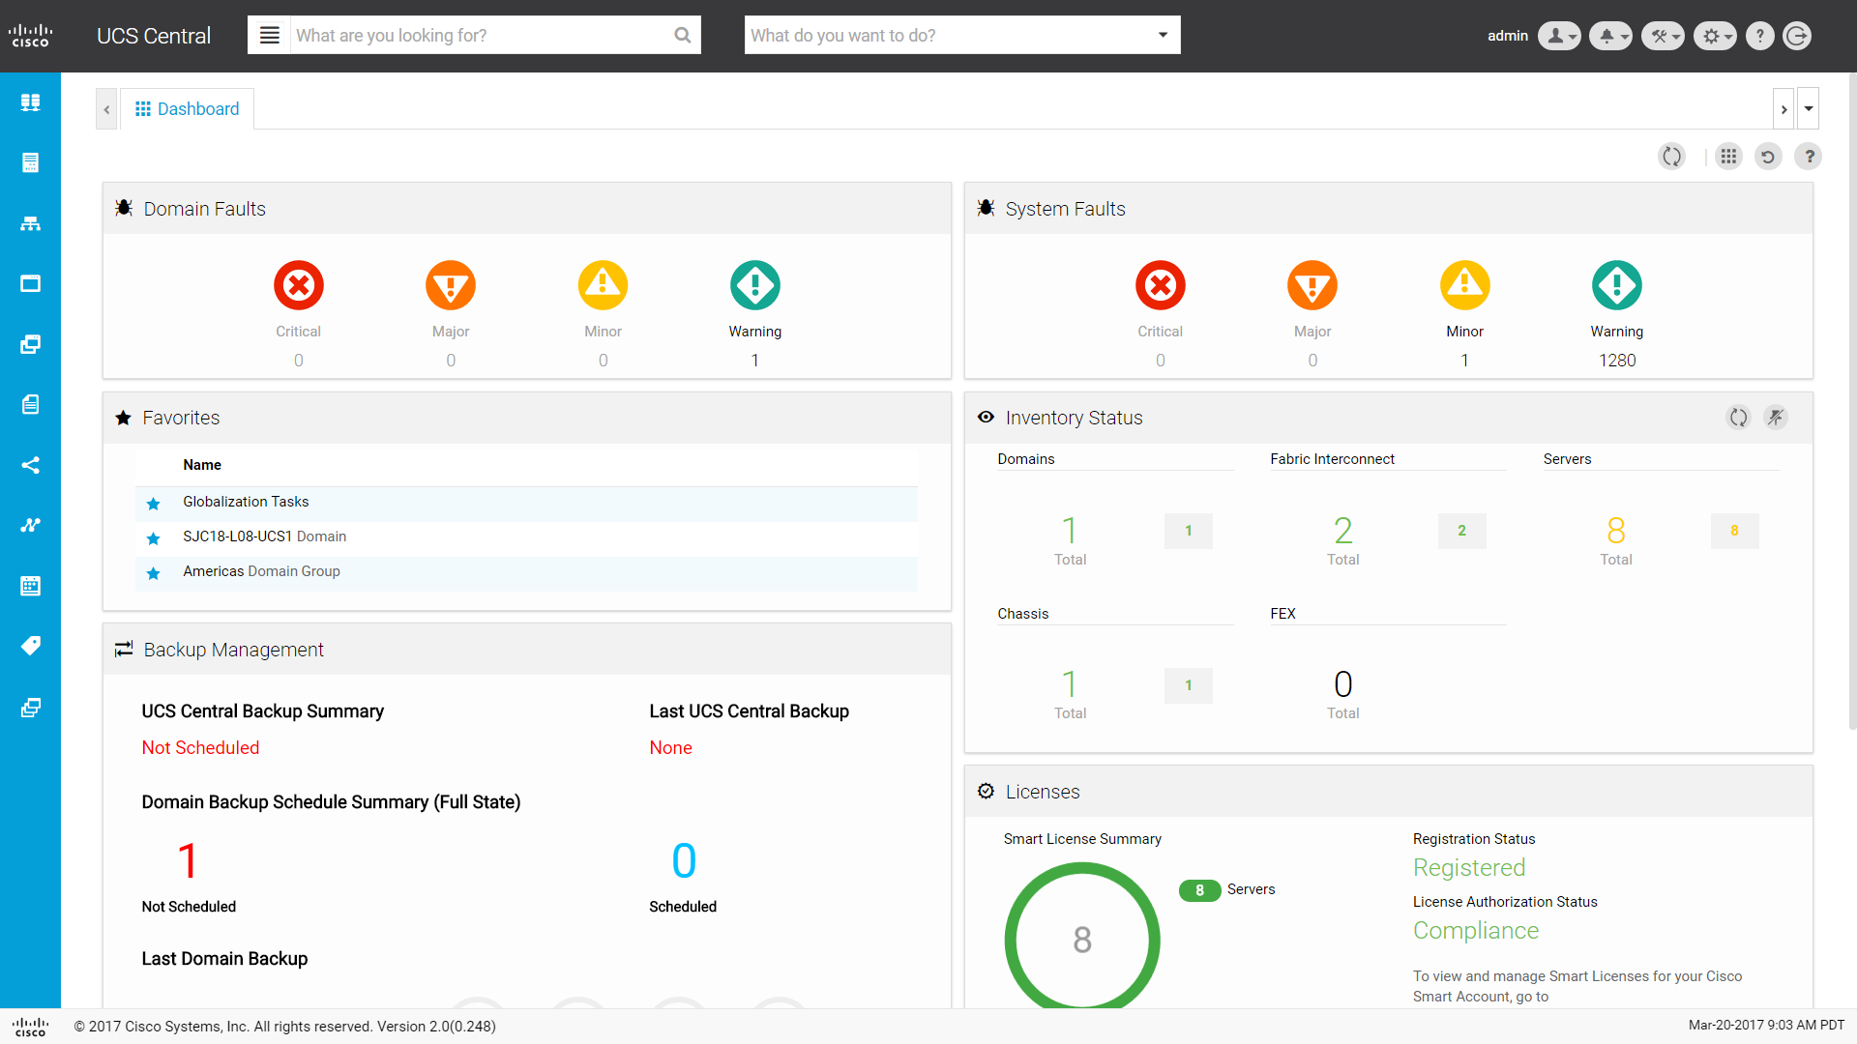
System management – UCS Central
UCS Central Across
Multiple Domains
Notes:
UCS Manager/UCS Central does:
Provisioning
Configuration changes
Inventory
Diagnostics
Monitoring, fault detection
Auditing, statistic collection

Slide 18
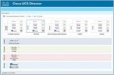
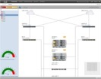














Current Cisco UCS ecosystem
Integrations
Customization
Cisco UCS tools
UCS Director
UCS Performance manager
Third party integrations
Customer tools and portals
Cisco tools
API
UCS Management
Policy and model driven infrastructure
UCS Mini
UCS B-Series
UCS C-Series
HyperFlex Systems
UCS S-Series
Servers
Hyperconverged
Storage
Notes:
The XML API facilitates integration with a wide range of third party management tools from more than a dozen vendors The API allows for custom integration and portals using the Cisco PowerTool for PowerShell and the Python SDK.
The API also serves as the interface to higher level Cisco UCS tools, including UCS Director and UCS Performance Manager.

Slide 19
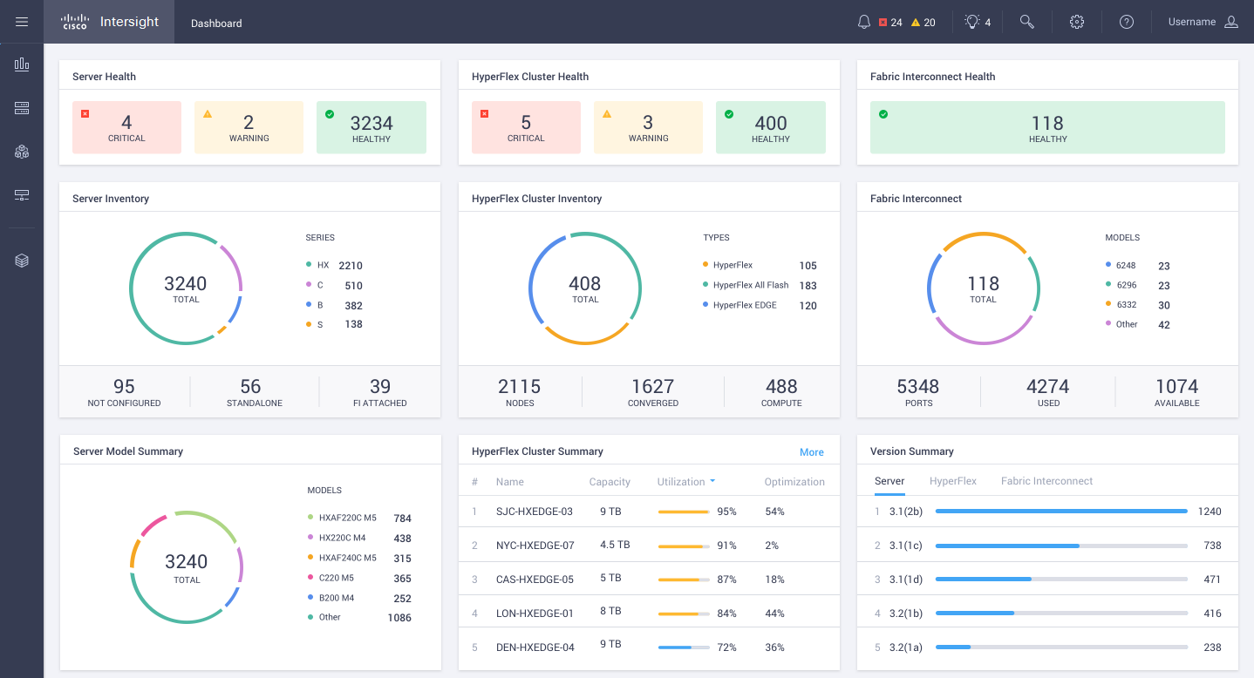
System management - Intersight
Consolidated view of UCS managed servers, HyperFlex, and stand-alone C-Series
Launch element managers in context
Proactive support capabilities
Deploy HyperFlex clusters
Notes:
UCS Manager/UCS Central does:
Provisioning
Configuration changes
Inventory
Diagnostics
Monitoring, fault detection
Auditing, statistic collection

Slide 20



Intersight extensible architecture
Shared architecture
Extensible functions
Inventory
and alerting
Security
and
authentication
Orchestration
Northbound API
To Intersight Portal
Core
Engine
Open Connector Framework
New connectors
UCS HW
connector
(XML/REST)
Partner
developed
connectors
To Infrastructure
Example: Converged infrastructure solutions
(BU/Cust./3rd party)
Future connectors

Slide 21
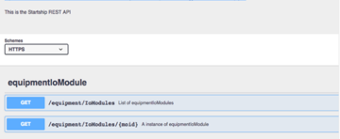







Extensible architecture
Advanced integrations
Intersight portal
Inventory
and alerting
Security
and
authentication
Orchestration
OData Restful API
Example: Tools and SDK
Open Connector Framework
New connectors
UCS HW
connector
(XML/REST)
Partner
developed
connectors
(BU/Cust./3rd party)
Cisco and 3rd party infrastructure
Notes:
The Device Connector framework features one programming model for integrating infrastructure and operations management tools
Deploy, configure, manage, and monitor: at scale, all from one API
SDK and DevOps tools integrations
OData: interoperable RESTful API
OData: a RESTful API Specification
Microsoft Azure, SAP, many others export OData APIs
http://www.odata.org/ “the best way to rest”

Slide 22



Average 62% reduction of ongoing administrative management costs
Based on 61 customer case studies
Support time was also cut dramatically. Thomas and the rest of the team have been freed to work on new projects in what he estimates is a twentyfold increase in productivity. Time saved is now being directed toward expanding the internal team’s expertise and experience with other technologies and applications, as well as launching new initiatives.
Consequently, PLAZAMEDIA service provisioning and change management are five to 10 times faster than before, while server decommissioning can be accomplished at least 50 percent faster. Increased administrative efficiency has freed IT staff to concentrate on more strategic issues.
The amount of time spent on maintenance work has been reduced by 86 percent.
Notes:
Examples from published case studies. Main repository for case studies - http://www.cisco.com/en/US/solutions/ns340/ns517/ns224/dc_case_studies.html
Pitt Ohio Express - http://www.cisco.com/en/US/solutions/collateral/ns340/ns517/ns224/Cisco_Pitt_Ohio_CS_090810.pdf
PLAZAMEDIA GmbH - http://www.cisco.com/en/US/solutions/collateral/ns340/ns517/ns224/plazamedia_external_casestudy_fnl_12_17_13.pdf
EDIF Holding SPA - http://www.cisco.com/en/US/prod/collateral/modules/ps2706/ps6906/edif_cs.pdf

Slide 23
Provisioning
Ongoing administration
Servers
Servers
Infrastructure and cabling
Power and cooling
System management
Real world TCO examples

Slide 24
Server cost reduction
Eliminate i/o adapters
Virtual Interface Cards and Unified Fabric
Pool and Reduce Hot Spares Using UCSM Service Profiles
Eliminate Management Servers
Improve Consolidation with Large Memory and
Industry-leading Performance
Buy fewer servers
Notes:
The chevron has the savings, the callout text has the how. The payoff for each chevron is covered on the remaining slides in the section.

Slide 25
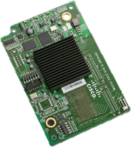
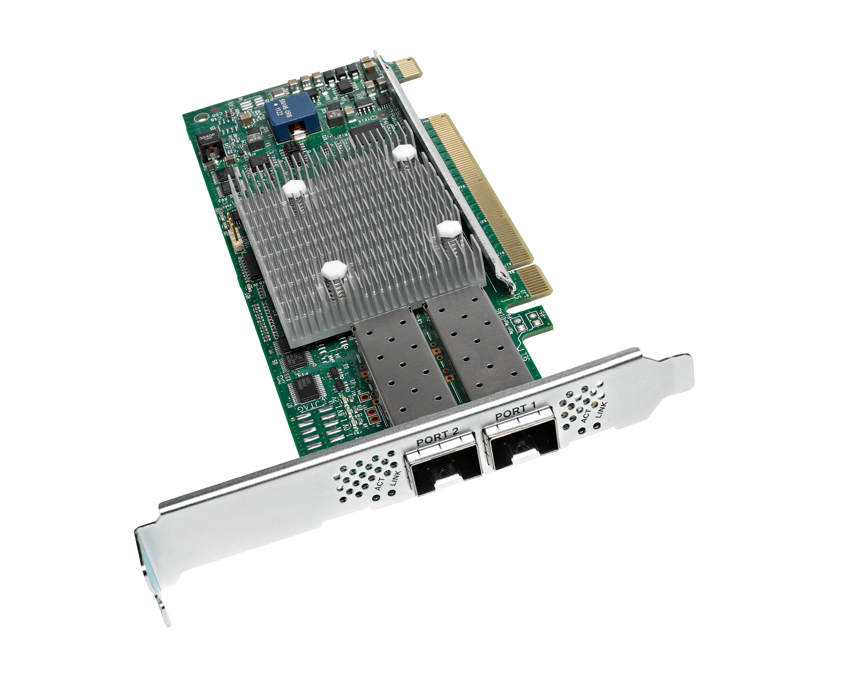

Virtual interface cards
Replaces traditional approach of
multiple NICs and HBAs per Server: SingleConnect
Over 256 Interfaces vs.
8 to 64 per
2-Port Adapter
Up to 80 Gb Bandwidth vs. 20 Gb
VM-FEX
Notes:
Our newest VICs allow for up to 256 instantiations of either NICs or HBAs per physical device limited by the OS. This allows for greater fine tuning of bandwidth per VM or connection. The average “competitive” only allows for 8, with the max being 14.
Cisco is only vendor offering a mezz card that supports up to 80Gbps per adapter. Every other vendor only supports 20Gb.
Virtual Machine Fabric Extender (VM-FEX) - collapses virtual and physical networking into a single infrastructure. Data center administrators can now provision, configure, manage, monitor, and diagnose virtual machine network traffic and bare metal network traffic within a unified infrastructure.
The VM-FEX software extends Cisco fabric extender technology to the virtual machine with the following capabilities:
Each virtual machine includes a dedicated interface on the parent switch
All virtual machine traffic is sent directly to the dedicated interface on the switch
The software-based switch in the hypervisor is eliminated

Slide 26
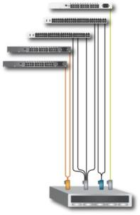


Eliminating server I/O adapters
Ethernet Management Network Switch
Cisco UCS Fabric Interconnects
Ethernet Top-of-Rack Switches
Fibre Channel
Top-of-Rack Switches
Cisco Nexus Fabric Extenders
1 x 1-Gbps Management
2 x 1-Gbps Production Data
1 x 1-Gbps Production Data
1 x 1-Gbps vMotion
1 x 1-Gbps VM Console
1 x 1-Gbps VMkernel
2 x 8-Gbps Fibre Channel
2x 10/40-Gbps Unified Fabric Data and Management
Traditional Rack Server | Per Server | Cisco UCS C-Series Rack Server
4 | Physical NICs/HBAs | 1
9 | Cables | 2
Notes:
The left shows a traditional, legacy deployment of 1Gb and FC for VMware vs. Cisco on the right with a VIC.

Slide 27
Buy fewer servers
Database
Web
Without UCS Service Profiles:
Silos Individually Provisioned for Peak Demand and Failures
Idle Hotspare Servers Require Application-Specific HW and Firmware Image Configurations
With UCS Service Profiles:
Configure and Provision Bare Metal on the Fly with Application-specific Service Profile Templates
Availability and Burst Capacity Delivered with Fewer Spares
Database
Web
Rack
Blade
Rack
Blade
Rack
Blade
Rack
Blade
Rack
Blade
Rack
Blade
Rack
Blade
Blade
Rack
Blade
Virtualized Apps
Blade
Blade
Blade
Virtualized Apps
Blade
Blade
Spares Pool
Blade
Blade
Blade
Blade
Blade
Blade
Total Servers: 18
Rack
Blade
Blade
Total Servers: 14
Blade
Live/Production
Burst Capacity Spare
Hot Spare
Notes:
Treat servers as raw computing capacity
Group servers by capability, not location
Socket count, processor, RAM, local disk etc.
Allows spare, burst, or DR servers to be shared reducing overall server count

Slide 28
Buy fewer servers
Cisco UCS: 151 world records
Superior technology fueling industry-leading application performance
34
17
19
17
33
22
9
CPU
Virtualization/Cloud
Database
Enterprise Application
Enterprise Middleware
HPC
Big Data
Superior Performance
Improved end-user experiences
Increased business velocity
Reduced software licensing costs
Reduced infrastructure footprint
Cisco UCS Benchmarks that held world record performance records as of date of publication . Details at https://www.cisco.com/c/en/us/products/servers-unified-computing/industry_benchmarks.html

Slide 29
Buy fewer servers
Cisco UCS: 151 world records
Superior technology fueling industry-leading application performance
Fewer VMware Licenses
17
Virtualization
$995–$3,495+
$323–$874 Support
Cisco UCS Benchmarks that held world record performance records as of date of publication . Details at https://www.cisco.com/c/en/us/products/servers-unified-computing/industry_benchmarks.html

Slide 30
Cisco UCS S3260: Modular platform
Massive Capacity
600TB data storage capacity in 4U
Spinning Disk and SSD
Multi-Node Power
Single or Dual Server Options
New cache acceleration capabilities with NVMe and Fusion IoMemory
I/O flexibility
40Gb Cisco Virtual Interface Card (VIC) Technology
256 virtual adapters per node plus 16Gb native Fabre
Channel options
Total Automation
Scale to Petabytes in minutes with UCS Manager
Cisco SystemLink Technology with flexible storage profiles
Significant Benefits Compared to Conventional 2RU Servers
    34%
    Lower
    Capex
    80%
    Lower Ongoing
    Management
    70%
    Less
    Cabling
    60%
    Less
    Space
    59%
    Lower
    Power
Notes:
Massive 600TB data storage capacity
Scale to Petabytes in minutes with UCS Manager
New cache acceleration capabilities with NVMe
Flexible connectivity from Ethernet to Fiber Channel
Faster network access with 40Gb VIC support
Cisco BIDI transceivers enable 40G over 10G cabling

Slide 31
S-Series advantage
46% TCO savings over Amazon S3
Network Connection
Support Labor Cost
RHEL License
Hardware Warranty
Standard
Storage Fees
3-Year Analysis of S-Series vs. Amazon AWS S3
420TB AWS capacity, 600TB Raw on S3260
Comprehensive model of all OPEX and CAPEX elements for on-prem and cloud scenarios
16 month break-even
S3260 and AWS S3 US West Oregon pricing as of 2017-02-03
Hardware Capital
Datacenter Overhead
Power & cooling
Sys Admin Labor Cost
UCS S3260
On-Premises
Amazon S3
Months

Slide 32
Provisioning
Ongoing administration
Infrastructure
and cabling
Servers
Infrastructure and cabling
Power and cooling
System management
Real world TCO examples

Slide 33
Infrastructure cost reduction
Eliminate switches
Unified Fabric for Blade and Rack Servers
Eliminate cables
Fewer Switches = Fewer Cables
Notes:
The chevron has the savings, the callout text has the how. The payoff for each chevron is covered on the remaining slides in the section.

Slide 34
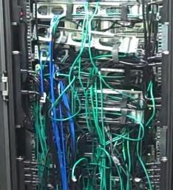
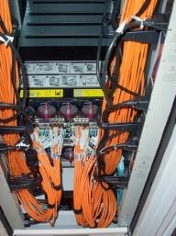
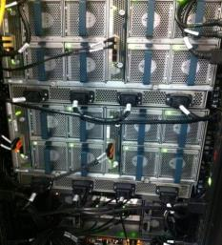
UCS cabling: Radical simplification
Traditional Rack
Traditional Blade
Cisco UCS
Ad Hoc and Inconsistent
Structured, but
Siloed and Complicated
Simplified
Notes:
Wire once then manage connectivity through software vs. pulling cables.

Slide 35
Evolution of complexity
Traditional Rack
FC Switch
Infrastructure
Enet Switch
Rack Mgrs
Servers
40 x
Rack Servers
2 x FC Switches
2 x Enet Switches
2 x Rack Mgrs for
40 Rack Servers
Notes:
Complexity persists in the traditional rack server environment and was carried forward in the evolution to blades.
The “Traditional Rack” graphic shows 40 1RU servers with TOR switching.
The right graphic shows how other vendors simply collapsed the switching infrastructure for 40 servers into the same design for 16 servers.
Contact slide author (M. Sean McGee; seanmcgee@cisco.com) for slide updates or explanation if needed.

Slide 36
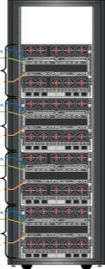
Evolution of complexity
Traditional Rack
Replicate Complexity
for Every 16 Servers
FC Switch
Infrastructure
Enet Switch
Rack Mgrs
2 x Enet Switches
Infrastructure
2 x FC Switches
16 x Blade Servers
Mini-Rack
1
2 x Chassis Mgrs
Servers
2 x Enet Switches
Infrastructure
2 x FC Switches
Mini-Rack
2
16 x Blade Servers
Servers
Servers
40 x
Rack Servers
2 x FC Switches
2 x Enet Switches
2 x Rack Mgrs for
40 Rack Servers
2 x Chassis Mgrs
2 x Enet Switches
Infrastructure
2 x FC Switches
Mini-Rack
3
16 x Blade Servers
Servers
2 x Chassis Mgrs
2 x Enet Switches
Mini-Rack
4
Infrastructure
2 x FC Switches
16 x Blade Servers
Servers
2 x Chassis Mgrs
Notes:
Complexity persists in the traditional rack server environment and was carried forward in the evolution to blades.
The “Traditional Rack” graphic shows 40 1RU servers with TOR switching.
The right graphic shows how other vendors simply collapsed the switching infrastructure for 40 servers into the same design for 16 servers.
Contact slide author (M. Sean McGee; seanmcgee@cisco.com) for slide updates or explanation if needed.

Slide 37
Eliminating Complexity with Unified Fabric
Complexity in Traditional
Environments
Ethernet
Fibre Channel
Management
Notes:
Explanation of FEX architecture – combining multiple networks to a unified fabric which ties to the FEX for both rack and blades.

Slide 38
Eliminating Complexity with Unified Fabric
Unified Fabric
Single, Multi- Protocol Fabric
SingleConnect
Complexity in Traditional
Environments
Ethernet
Fibre Channel
Management
Notes:
Explanation of FEX architecture – combining multiple networks to a unified fabric which ties to the FEX for both rack and blades.

Slide 39
Eliminating Complexity with Unified Fabric
Unified Fabric
Cisco Fabric
Extender Architecture
Single, Multi- Protocol Fabric
SingleConnect
Physically Distributed, Centrally Managed
Complexity in Traditional
Environments
One Network Fabric
One Network
One Layer
SingleConnect
Ethernet
Fibre Channel
Management
Notes:
Explanation of FEX architecture – combining multiple networks to a unified fabric which ties to the FEX for both rack and blades.

Slide 40
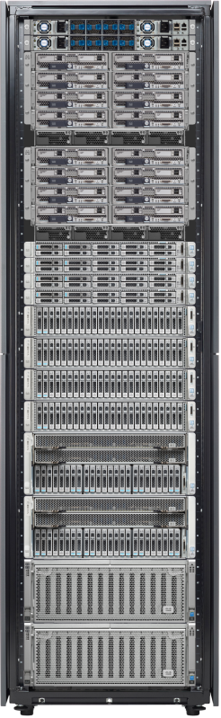
Fabric-Based infrastructure
Blade and rack
SingleConnect
Common access layer
networking model
Data, storage, and management combined
Cable for bandwidth
vs. connectivity
Management
Ethernet
Storage
Notes:
Lifetime cost of a cable - $500 - $1,000¹
Wire once for bandwidth, not connectivity
Ethernet, FCoE, iSCSI, management
Policy-driven bandwidth allocation
Tuned per server, vNIC, and vHBA
Changing protocols doesn’t require moving wires
Final result of a FEX architecture allows for a mix & match of rack and blade servers all being managed the same way, with the same tools.
1. IDC - The ROI of Converged Networking Using Unified Fabric (March 2011)
http://www.cisco.com/en/US/solutions/collateral/ns340/ns517/ns224/ns945/ns1060/white_paper_ROI_Converged_NW.pdf
The actual cable, connectors, labor to pull, labor to attach, etc.

Slide 41
Blade infrastructure costs: Chassis/switching
Blade chassis savings at scale–blade slot solution
Number of Chassis Slots
Cisco UCS 5108:
UCS 5108 chassis with UCS 6248 FI (Two Uplinks per FEX)
HPE c7000:
HPE c7000 Plat Chassis with 2x VC Flex Fabric FlexFabric 10Gb/24, OneView
HPE Synergy:
HPE 12000 Frame
VC SE 40Gb F8 and/or
10Gb Interconnect
Cisco and HPE c7000 pricing MSRP on October 3 2017; HPE Synergy pricing Product Bulletin on October 3 2017. All pricing is for blade chassis and networking only. Servers are not included.

Slide 42
Eliminating server I/O adapters
Ethernet Management Network Switch
Cisco UCS Fabric Interconnects
Ethernet Top-of-Rack Switches
Fibre Channel
Top-of-Rack Switches
Cisco Nexus Fabric Extenders
1 x 1-Gbps Management
2 x 1-Gbps Production Data
1 x 1-Gbps Production Data
1 x 1-Gbps vMotion
1 x 1-Gbps VM Console
1 x 1-Gbps VMkernel
2 x 8-Gbps Fibre Channel
2x 10/40-Gbps Unified Fabric Data and Management
Notes:
The left shows a traditional, legacy deployment of 1Gb and FC for VMware vs. Cisco on the right with a VIC.

Slide 43
Comparison of rack server I/O
 | Traditional Rack Server | Cisco Rack Server | Cisco Wins: Deltas
1 Server | 4 Adapters | 1 Adapters | 3
 | 9 Cables | 2 Cables | 7
10 Servers | 40 Adapters | 10 Adapters | 30
 | 90 Cables | 20 Cables | 70
50 Servers | 200 Adapters | 50 Adapters | 150
 | 450 Cables | 100 Cables | 350
100 Servers | 400 Adapters | 100 Adapters | 300
 | 900 Cables | 200 Cables | 700

Slide 44
Switching and cabling savings: Rack servers
Cisco UCS C240 M5 VIC VS. HPE DL380 Gen10 10Gb and FC
Savings Breakdown
Server hardware and warranty | 33%
Switch hardware and warranty, cabling | 61%
Power and cooling | 12%
Initial provisioning and ongoing server and networking administration | 39%
Systems management software licenses and warranty | 100%
3-Year TCO
36% overall savings
$19,497 3-year per node
overall savings

Slide 45
Switching and cabling savings: Rack servers
Cisco UCS C240 M5 VIC VS. HPE DL380 Gen10 10Gb and FC
Complexity of Traditional Rack Server Environment
10 Gb Ethernet Access
3-Year TCO
36% overall savings
$19,497 3-year per node
overall savings
Switch Hardware and
Warranty, Cabling: 61%
Fibre Channel Edge
OOB
Management

Slide 46
Switching and cabling savings: Rack servers
Cisco UCS C240 M5 VIC VS. HPE DL380 Gen10 10Gb and FC
VS.
3-Year TCO
36% overall savings
$19,497 3-year per node
overall savings
Switch Hardware and
Warranty, Cabling: 61%

Slide 47
Switching and cabling savings: Rack servers
Cisco UCS C240 M5 VIC VS. HPE DL380 Gen10 10Gb and FC
Simplified UCS Rack Solution
Fabric
Interconnects
3-Year TCO
36% overall savings
$19,497 3-year per node
overall savings
Switch Hardware and
Warranty, Cabling: 61%
Nexus 2232

Slide 48
Switching and cabling savings: Rack servers
Cisco UCS C240 M5 VIC VS. HPE DL380 Gen10 10Gb and FC
12 Fewer
Switches
3-Year TCO
36% overall savings
$19,497 3-year per node
overall savings
Switch Hardware and
Warranty, Cabling: 61%

Slide 49
Switching and cabling savings: Rack servers
Cisco UCS C240 M5 VIC VS. HPE DL380 Gen10 10Gb and FC
Servers and Warranty
Power and
Cooling
Provisioning and
Administration
Systems
Management
SingleConnect,
Networking, Cabling
and Warranty
Traditional Solution
UCS Solution
This graph compares the 3-year TCO for 96 HPE ProLiant DL380 Gen10 Servers with the 3-year TCO for 96 Cisco UCS C240 M5 Rack Servers. Each server has two Intel® Xeon® processor Gold 6134M CPUs, 192 GB of memory. HPE networking includes two x 10 Gigabit Ethernet and two 8-Gbps Fibre Channel connections for the servers and corresponding HPE switches. This is compared with the Cisco VIC 1387 mLOM dual-port 40-Gbps Unified Fabric adapter for Cisco rack servers and corresponding switches. Pricing is as of Sept. 5, 2017.
Notes:
Comparison of 96 HP rack servers using traditional 10Gb (x2) + FC (x2) vs. Cisco Unified Fabric. Focus callout is on switching & cabling.

Slide 50


Average 78% reduction in cabling with an average cost savings of 68%
Based on 34 and 10 customer case studies, respectively
“Where we previously needed 80 cables, we now only need eight: a reduction by the factor of ten. This not only cuts down the investment required, it also simplifies scalability. Installation and maintenance work are also substantially reduced.”
UCS has cut the number of cables required by more than 60 percent.
Almaviva Tele Sistemi Ferroviari - "Cabling costs alone have dropped by about 70 percent in the new data center, a significant figure because they used to represent up to 30 percent of each new deployment."
Notes:
Examples from published case studies. Main repository for case studies - http://www.cisco.com/en/US/solutions/ns340/ns517/ns224/dc_case_studies.html
Groupe Steria SCA - http://www.cisco.com/c/dam/en/us/solutions/collateral/switches/catalyst-6500-series-switches/steria_cs.pdf
Galliker Transport AG - http://www.cisco.com/en/US/solutions/collateral/ns340/ns517/ns224/ns944/Galliker_V3_Solution_Overview.pdf
Almaviva Tele Sistemi Ferroviari (TSF) - http://www.cisco.com/en/US/solutions/collateral/ns340/ns517/ns224/ns944/TSF_case_study.pdf

Slide 51
Provisioning
Ongoing administration
Power
and cooling
Servers
Infrastructure and cabling
Power and cooling
System management
Real world TCO examples

Slide 52
Power and cooling cost reduction
Unified Fabric for Blade and Rack Servers
Eliminate
Infrastructure
Fewer Servers
Fewer Switches
Notes:
The chevron has the savings, the callout text has the how. The payoff for each chevron is covered on the remaining slides in the section.

Slide 53
Power and cooling
System-level savings
Smaller blade server increments reduces
“stranded capacity”
Fewer adapters to support
I/O requirements
Easier power management with UCS Manager
  No extra software to buy saving both CapEx and OpEx
Industry-leading virtualization performance improves server consolidation ratios
Fewer switches with a
Unified Fabric
  In the chassis and ToR
Fewer cables for better airflow through the rack
Notes:
Stranded capacity
A fully configured competitive chassis to support 16 blades will draw more power at idle than one (Cisco) to support eight servers
Fewer adapters
This is more directed at rack servers than blades as most blades only use one mezz card
HPE charges iLO $299 for iLO Advanced and Dell charges $399 for iDRAC Enterprise – need this to support power capping; to forget warranty support services
Virtualization rates refers back to the benchmark slides
Fewer switches is both for the blade chassis – competitors tie a mezz card to a certain set of intra-chassis switches. If you add a second set, you add a 2nd mezz card and draw more power overall. For racks refer back to the 20 fewer switches slide
Cables can impede airflow in the back of the rack.

Slide 54

Average 52% Reduction In Power And Cooling Costs
Based on 75 customer case studies
“We funded the implementation of Cisco UCS with an energy efficiency grant from Salix Finance and The Higher Education Funding Council for England. So far, we’ve seen a 10 percent reduction in power usage, and we expect the solution to pay for itself within 12 months.”
“The simplified design of the Cisco UCS Servers improves airflow efficiency and can reduce the number of components that need to be powered and cooled by more than 50 percent compared to traditional blade server environments.”
Server utilization has increased by 40 percent while data space, power, and cooling have been reduced by the same amount.
Notes:
Examples from published case studies. Main repository for case studies - http://www.cisco.com/en/US/solutions/ns340/ns517/ns224/dc_case_studies.html
Groupe Steria SCA - http://www.cisco.com/c/dam/en/us/solutions/collateral/switches/catalyst-6500-series-switches/steria_cs.pdf
Galliker Transport AG - http://www.cisco.com/en/US/solutions/collateral/ns340/ns517/ns224/ns944/Galliker_V3_Solution_Overview.pdf
Almaviva Tele Sistemi Ferroviari (TSF) - http://www.cisco.com/en/US/solutions/collateral/ns340/ns517/ns224/ns944/TSF_case_study.pdf

Slide 55
Provisioning
Ongoing administration
System management
Servers
Infrastructure and cabling
Power and cooling
System management
Real world TCO examples

Slide 56
System management software
Eliminate systems management licensing
UCS Manager Embedded in the Product,
No Additional Charge
Eliminate
management servers
UCS Manager Runs in the Fabric Interconnects,
Accessed via API
Notes:
The chevron has the savings, the callout text has the how. The payoff for each chevron is covered on the remaining slides in the section.

Slide 57
Complexity vs. simplicity
Function | Legacy HPE | Cisco
Local and Remote Administration | iLO/Onboard Administrator | UCS Manager
Detect Hardware Faults | Systems Insight Manager
Update System Software | Systems Insight Manager
Inventory Tracking | Systems Insight Manager
Spot Deploy Critical Server Updates | Onboard Administrator
Virtualized LAN/SAN Connectivity | Virtual Connect
Multi-chassis Address Server Management | Virtual Connect Enterprise Manager
Logical Server Abstraction | Matrix Operating Environment
Power Management | Insight Control/iLO
Required Management Interfaces | 7 | 1
Notes:
Simplicity vs. complexity
iLO - $299; Insight Control - $399; VCEM - $3,999
Integrated- 1 management point vs. layered - many points of management
Author's Original Notes:
VCEM is required to move server profiles between enclosures
VCM is used as single management interface to control all Enet and FC modules in the enclosure. VCM is also used to create/manage server profiles.
An external interconnect IS required for HPE in order for blade servers to communicate with each other.
OA is used as the FEX but has it’s own management interface. OA is used to manage each enclosure.
iLO is used mostly as a remote KVM per server. We point out that iLO is a separate management interface because firmware has to be individually upgraded.
NIC advanced settings aren’t controlled by HPE management apps like UCSM does. So, separate interface compared to UCS.

Slide 58
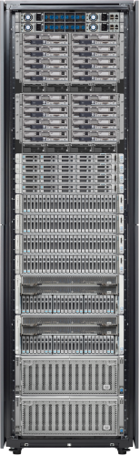
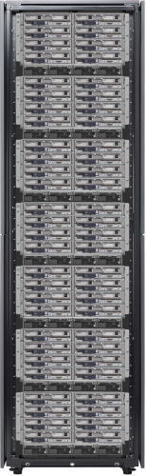
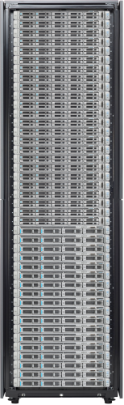
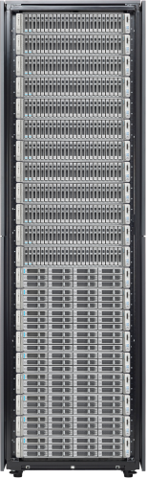
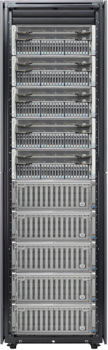


UCS Eliminates management SW complexity
Legacy HPE c7000
Cisco UCS
HPE Server Hardware Management; Multiple Layers of Software Required
UCS Manager - One Console,
No Added Cost - Blade and Rack
Virtual Connect Enterprise Manager
Insight Control
System Insight Manager
Virtual Connect Manager
Virtual Connect Manager
Virtual Connect Manager
Virtual Connect Manager
iLO Advanced
for BladeSystem
iLO Advanced
for BladeSystem
iLO Advanced
for BladeSystem
iLO Advanced
for BladeSystem
Onboard Administrator
Onboard Administrator
Onboard Administrator
Onboard Administrator
Up to 160 Blade and Rack Servers
No Mixing of Rack and Blade
Unified Management and Unified Fabric
Separate Management: Every Chassis, All Software
Separate Ethernet and Fibre Channel I/O Leaving the Chassis

Slide 59
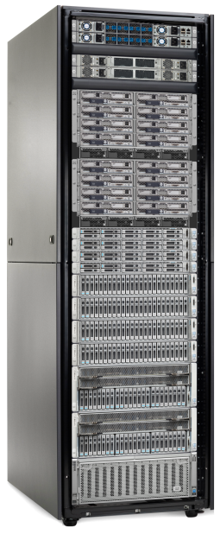

UCS Eliminates management HW complexity
HPE OneView
Cisco UCS
HPE Server Hardware Management; Multiple Layers of Software Required
UCS Manager - One Console, No Appliance
No Added Cost, support for Blade and Rack
c7000
Synergy
OneView
(Virtual Appliance)
Synergy OneView
Synergy
Composer HW
Synergy
Composer HW
Virtual Connect
Virtual Connect
Synergy Frame Link Module (FLM)
Synergy Frame Link Module (FLM)
iLO Advanced
for BladeSystem
iLO Advanced
for BladeSystem
Synergy Fabric Modules
Synergy Fabric Modules
Onboard Administrator
Onboard Administrator
Interconnect Link Modules
Interconnect Link Modules

Slide 60


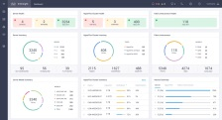


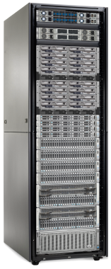
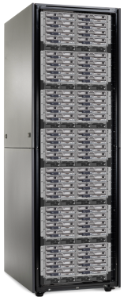




UCS Eliminates management SW complexity
HPE OneView Dashboard
Cisco UCS Central or Cisco Intersight
HPE Dashboard
UCS Central
Cisco Intersight
Global Policies
Global RBAC
Global Backup and Recovery
or
Geo A
Geo B
Geo A
Geo B
OneView 3.0
Virtual Appliance
OneView 3.0
Virtual Appliance
Synergy OneView
Physical Appliance
Synergy OneView
Physical Appliance
Synergy
Proliant
Synergy
Proliant
UCS
UCS

Slide 61

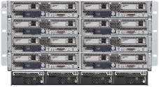


Extend reach of SMEs globally
UCS Manager
Server
Chassis
Domain
Notes:
Reiterate UCS Manager and UCS Central

Slide 62


Extend reach of SMEs globally
UCS Central or Cisco Intersight
UCS Manager
Server
Chassis
Domain
Single Data Center
Global Data Centers
Notes:
Reiterate UCS Manager and UCS Central

Slide 63
Provisioning
Ongoing administration
Real world TCO examples
Servers
Infrastructure and cabling
Power and cooling
System management
Real world TCO examples

Slide 64

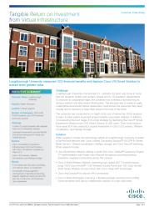
Loughborough University
“When we compared the legacy server and network with one based on Cisco UCS, TCO effectively halves over a five-year investment lifecycle.”
Dr. Phil Richards
Director of IT, Loughborough University
Notes:
Link to full study - http://www.cisco.com/en/US/solutions/collateral/ns340/ns517/ns224/loughborough.pdf

Slide 65
Loughborough University
Savings Breakdown
Server hardware and warranty | 38%
Switch hardware and warranty, cabling | 80%
Power and cooling | 49%
Initial provisioning and ongoing server and networking administration | 79%
Virtualization software licenses and warranty | 39%
5-Year TCO
48% overall savings
$18,542 5-year per node
overall savings
Notes:
Link to full study - http://www.cisco.com/en/US/solutions/collateral/ns340/ns517/ns224/loughborough.pdf

Slide 66
Loughborough University
$871,476
Savings
$2.0M
$1.8M
$1.6M
$1.4M
Servers and Warranty
$1.2M
Networking, Cabling
and Warranty
$1.0M
Power and
Cooling
Provisioning
Existing Rackmount Solution
$0.8M
Virtualization
Software
$0.6M
UCS Solution
$0.4M
$0.2M
$0
Comparison of existing 47 rack servers and associated switching infrastructure plus projected growth transitioning to Cisco UCS B200. 5-year lifecycle.
Study conducted May 1, 2012 to July 26, 2012.

Slide 67
Major travel services provider
Savings Breakdown
Server hardware and warranty | 18%
Switch hardware and warranty, cabling | 54%
Power and cooling | 69%
Initial provisioning | 79%
5-Year TCO
39% overall savings
$11,522 5-year per node
overall savings
Notes:
Link to full study - http://www.cisco.com/en/US/solutions/collateral/ns340/ns517/ns224/loughborough.pdf

Slide 68
Major travel services provider
$5,553,638
Savings
$14M
$13M
Servers and Warranty
$12M
$11M
Networking, Cabling
and Warranty
$10M
Competitor’s Rackmount Solution
$9M
Power and
Cooling
$8M
Initial
Provisioning
$7M
UCS Solution
$6M
$5M
Comparison of existing 482 rack servers and associated switching infrastructure plus projected growth vs. Cisco UCS B-Series. 5-year lifecycle.
Study conducted May 2011 to September 2011.
Notes:
Data Center Case Studies - http://www.cisco.com/en/US/solutions/ns340/ns517/ns224/dc_case_studies.html

Slide 69
Real innovation improves TCO
Servers and Warranty
SingleConnect,
Networking, Cabling
and Warranty
Power and
Cooling
Traditional Solution
Unified Fabric
Radical infrastructure simplification
Efficient scaling
High performance
Provisioning and
Ongoing Administration
Systems
Management Software
Unified Management
Embedded device management
Self-integrating
Stateless
Automated
Programmable
UCS Solution
Notes:
We can then group these buckets into two categories: Unified Fabric & Unified Management

