Slide 1
Accelerating Business Transformation by Simplifying the Cloud Deployment Models

Slide 2



Speed of technology transition is accelerating
Digital transformation
Trends
AI
ML
IoT
IT infra impact on the DC
Speed
Simplicity
Visibility
Compliance
Investment
protection
User experience application performance

Slide 3

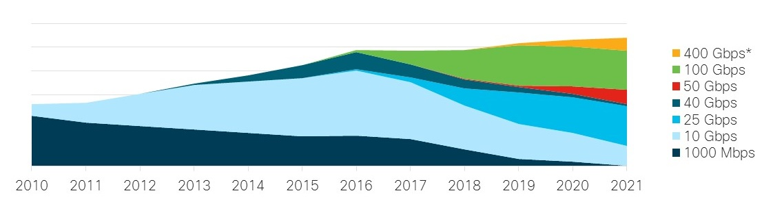
Current trends
Simplicity
Visibility
Compliance
Investment protection
Speed . Performance. Scale
10→25G access – starting in 2018 servers are equipped with 25G, support diverse multi-cloud apps
40→50/100 core – support high density data,
maintaining SLA
100→400 DCI – Robust BC by means of Better DR, Active-active DC
Impact of new workloads on network
Dell’Oro: Ethernet Switch – Data Center Five Year Forecast Report 2017 – 2021 (Fixed and Modular)

Slide 4
Automate to reduce OPEX
Speed
Visibility
Compliance
Investment protection
Simplicity
Easy deployment options: zero touch provisioning, open APIs, GUI based
Flexible architectures : consolidated LAN/SAN, multispeed, 2/3 tier architectures,
Reduced OPEX through automation
SDN and Devops tools

Slide 5

You can’t protect what you can’t see!
Speed
Simplicity
Compliance
Investment protection
Visibility
Enhanced real-time network visibility and flow visualization for faster troubleshooting and remediation of performance issues.
Pervasive Telemetry yielding application
behavior baselining
Detect applications running the risk of security compromise
Gartner predicts that, through 2020,
99% of vulnerabilities exploited will
continue to be the ones known by
security and IT professionals for
at least one year.

Slide 6

Do you need to
Speed
Simplicity
Compliance
Investment protection
Compliance
Predict the impact of changes?
….make changes confidently while reducing the risk of network failures caused by human errors
Verify network-wide behavior?
.…eliminate potential network outages and vulnerabilities
Assure network security policy and compliance?
….checking for compliance against business rules

Slide 7

Speed
Simplicity
Compliance
Compliance
Investment protection
Enabler for future innovations
Modern applications require superior hardware performance, more speed for existing port density and granular security
Backward compatibility
Scaling physical infrastructure with new application requirements is cost prohibitive
No fork lift upgrades
Rapid Software innovations require incremental hardware addition

Slide 8


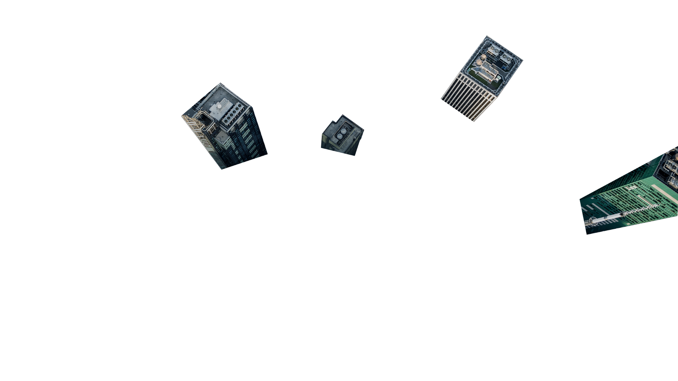
How to Meet These Demands
C97-741145-00 © 2018 Cisco and/or its affiliates. All rights reserved. Cisco Partner Confidential
Notes:
The changing business landscape has had a significant impact and created a “new normal” for IT as they evolve their data center and cloud strategy in three ways:
App is the New Business: In any business, in every industry, applications are the key driver of success. And every data center or cloud on this planet is built to do one thing: run apps. For IT, this creates the need for a data center that’s able to deliver massive, elastic, and intelligent bandwidth and scale. A data center that can deliver security for every app, every platform, every device that exists within that business—from customers to employees to partners. A data center where 100 percent availability 100 percent of the time is now the operating mandate.
The Developer is the New Customer: Today, new apps are custom-built, updated by the minute often with shelf-life of a few days. For IT this means that everything they do and every decision they make regarding their technology, infrastructure, and the entire business must serve the needs of developers as the primary customer. Application developers and DevOps teams now wield considerable influence and budget. IT organizations must support developers and operate in a DevOps model as a focal areas of their success.
Multi-Cloud is the New Data Center: Apps today are not one thing and they do not “live” in one place. They operate in multiple public, managed and private cloud environments as shown by the fact that more than 70 percent of enterprises today saying that the have a hybrid cloud strategy with almost 85 percent reporting their intention to use multiple clouds (IDC). So, Multi-Cloud is no longer a choice. Going there is a decision is made often on-demand and, often, automatically—based on the intent of the business.

Slide 9
Speed/Performance

Slide 10

Everything is speeding up
Ethernet
25->50-> 100-> 400G
LAN
SAN
Fibre Channel
16->32->64 >128

Slide 11

Faster applications
Micro-services based approach
Multi-cloud execution

Slide 12
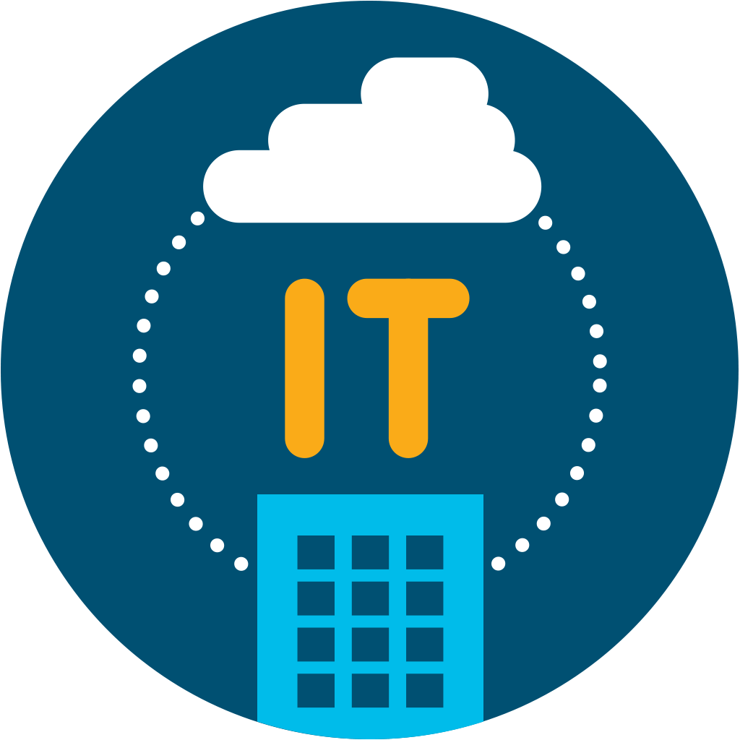
It doesn’t need to be complex.
Scale without sacrificing performance and security.
C97-741145-00 © 2018 Cisco and/or its affiliates. All rights reserved. Cisco Partner Confidential

Slide 13

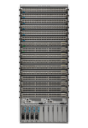


Delivering fabric wide cloud scale and services
Nexus 9000 powered Cisco Cloud Scale ASIC
Best of breed switching
Industry leading programmable switch
Superior Performance
Visibility and security Pervasive
Reduced Power
Optimized Price
Nexus 9300
Nexus 9500
Network automation
with ACI
A generation ahead
Industry
leading analytics
Investment Protection

Slide 14
Nexus 9000
Powered by NXOS/ACI
Managed by DCNM

Slide 15

See how Nexus with Cloudscale helped Shutterfly to scale and reduce cost
Shutterfly
Millions of customers
Free, unlimited photo storage
Photo-based products and services
Mobile and Web apps
200+ Petabyte of Data

Slide 16

What does it mean to their network?
Provides compelling user experience with traffic growth
Automates switch
provisioning to save time
Simplifies management

Slide 17
Upgrade network with Cisco Nexus 9000 Switch across multiple data centers

Slide 18
Mobile and Web apps
200+ Petabyte of Data
Nexus Powered by Cloudscale ASIC
NX-OS/Open API
During the holidays—our busiest season—we were able to sustain a
40 percent increase in traffic with no performance degradation whatsoever
Provisioning tasks that used to
take 3 to 4 person hours are now automated, saving approximately
$400 each time
— Arslan Munir,
Director of Cloud Engineering, Shutterfly
— Jeremy Franzen,
Director of Network Operations, Shutterfly

Slide 19

See how square Enix scaled their production and development environments for high performance
Square Enix is known for role-playing game series, such as
“Final Fantasy” and “Dragon Quest,” which received tremendous
response from players all over the world.

Slide 20
Current challenges
Increase in volume of data during development phase, need better performance to handle the load
Rapidly build a system environment that would act as the new foundation for future development and handle peak loads
Performance and
cost-effectiveness

Slide 21
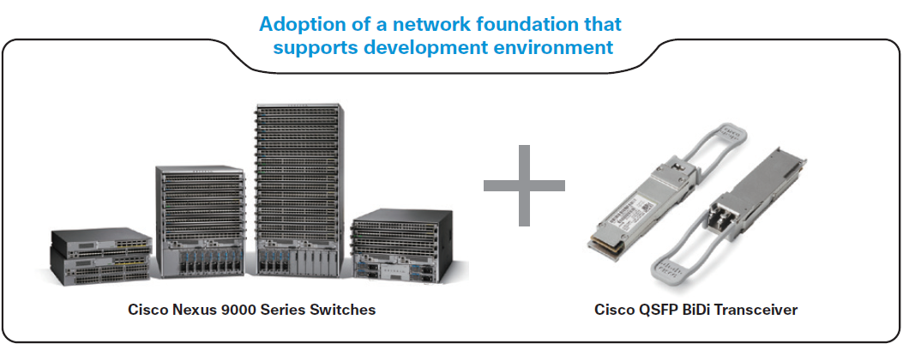
Solution
Adoption of a network foundation that
supports development environment
40G today, 100G tomorrow – Same infrastructure
Cisco Nexus 9000 Series Switches
Cisco QSFP BiDi Transceiver
“Since the implementation of the product, there have been no troubles in its operation. Development hasn’t experience any issues either. On the contrary, the solution helped reduce frustration at work. The work environment is up to expectations.”
— Hajime Tomon, Information Systems, Square Enix, Japan

Slide 22
Simplicity
Choices for programmability and automation

Slide 23

What problem are we trying to solve?
“I can spin up servers in minutes with my
Configuration Management Tool workflows,
why does it take orders of magnitude more to
spin up and affect change on my Network Elements?”
— Network Administrator

Slide 24
Your Data center is unique
But one thing all of them have in common is
Automation can make it easier and faster

Slide 25
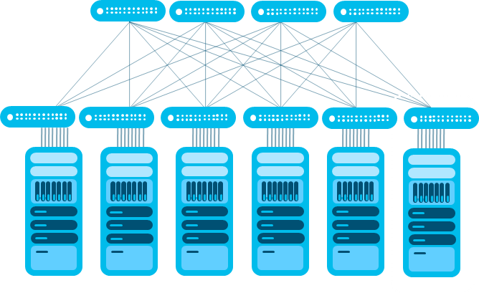
Choice for programmability and automation
Start with NXOS out of the box automation
POAP and XMPP out of the box are great options to bring up individual switches in an automated fashion

Slide 26
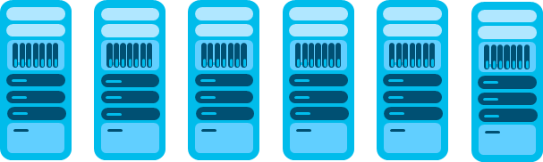
Choice for programmability and automation
Then use DCNM for VXLAN overlay provisioning
OR
Take advantage of open NXOS-APIs:
Leverage DevOPs support including Puppet, Chef, Ansible etc …
Bash Shell access and Linux container support
Utilize Python scripting
Leverage Open stack integration with Neutron

Slide 27


Choice for programmability and automation
For Internal use only
SDN with ACI for automation of overlay, and underlay networking, policy models, multi-hypervisor support, service chaining, L4-7 integration, WAN interconnect and deployment, and more
ACI Anywhere – ready for the multi-cloud workloads
DB
DB
Microsoft
Web
Web
App
Web
App

Slide 28
Choice for programmability and automation
For External use only
SDN with ACI for automation of overlay, and underlay networking, policy models, multi-hypervisor support, service chaining, L4-7 integration, WAN interconnect and deployment, and more
ACI Anywhere – ready for the multi-cloud workloads
DB
vmware
DB
Microsoft
Redhat
Web
Web
App
Web
App

Slide 29

See how Nexus with Cloudscale helped Durham county to scale and reduce cost
Durham County of
North Carolina
One of the top 5 digital cities
in the United States
Serving 315,000 residents.
Running apps for paying bills, marriage licenses,
and managing county documents.

Slide 30

New technologies like SDN will help, but:
There’s a learning curve.
Not easy to find the
right resources
They needed turnkey solutions
Simple and easy to use

Slide 31

Cisco ACI + Nexus 9000 industry leading
SDN solution
Simple
Policy-based management
Open and easy to Integrate

Slide 32
20%
maintenance
20%
innovation
Results
80%
maintenance
80%
innovation
Flipped this model
Automated policy, greater visibility into network fabric,
robust application development architecture

Slide 33

Bank Central Asia accelerates service innovation with application-centric, software-defined infrastructure
Bank Central Asia (BCA) is one of the leading private banks in Indonesia, offering business transactions, credit loans, and financial solutions for
Size: 25,000 employees | Industry: Financial services | Location: Jakarta, Indonesia
16 million + corporate, commercial, and individual customers
Delivered through 1213 branches, 17,207 ATMs, more than 400,000 Electronic Data Capture (EDC) machines
24-hour Internet and
mobile banking

Slide 34


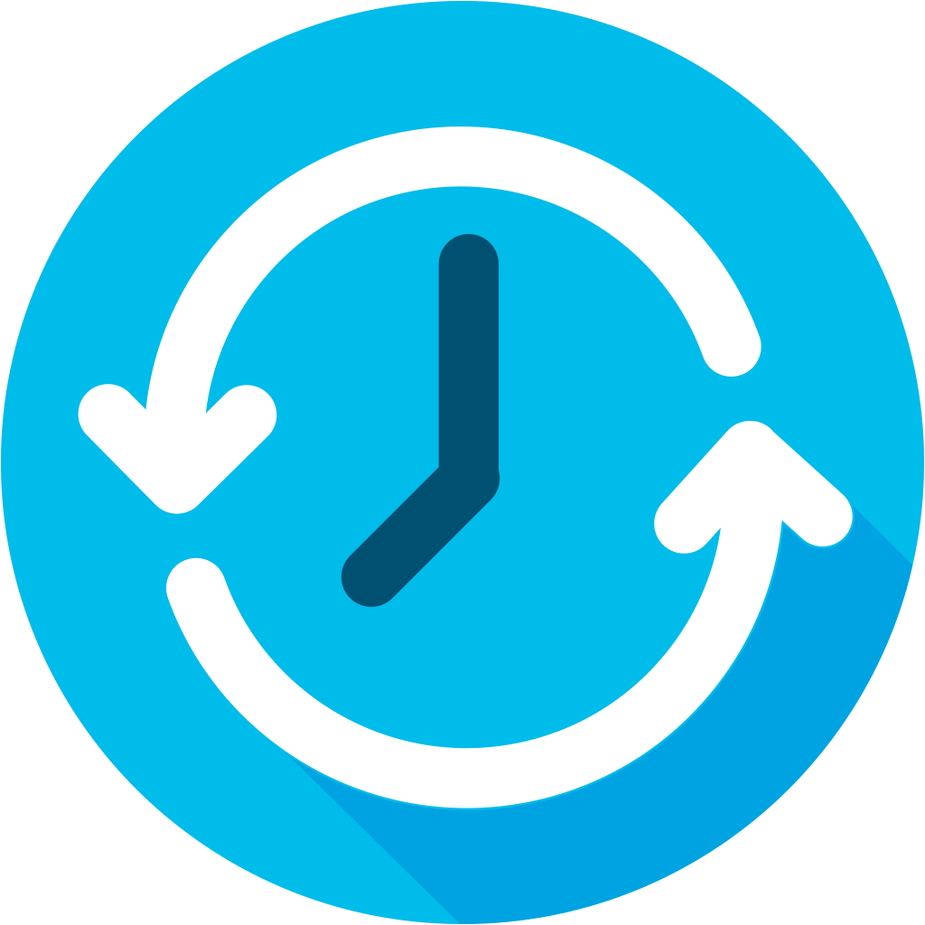

How do we…..
Protect sensitive client
and financial data
Maintain high availability
Increase operational agility and responsiveness
Accelerate service innovation

Slide 35
Bank Central Asia choose Cisco ACI/Nexus 9000
BCA Task | Before Cisco ACI | After Cisco ACI
Server connectivity | Configuration on each switch or router | Configuration through centralized management console (Cisco APIC)
Virtual Machine (VM) connectivity | 5 manual processes | 3 manual processes
New VM server for existing application | 10 to 20 minutes | 10 seconds
Endpoint physical port tracing | 5 to 10 minutes | 30 seconds
Capacity measuring | 10 to 30 minutes | 20 seconds
Network configuration | Manual | XML/JSON scripting through API
Cisco Nexus 9000 Powered by Cloudscale – for Scale and Performance
Application centric, software defined networking for centralized, automated infrastructure management

Slide 36
“In the past, we spent most of our time fulfilling requests from the server and application teams. Now we have the time to try new things, explore new products and features, and enhance our underlying systems and overall security posture.”
— Lily Wongso, Data Center Network Manager, BCA

Slide 37
Visibility
Identify network issues proactively and prevent outages

Slide 38
Sensors
Telemetry
Collector/Analyzer
Nexus 9000
Cloudscale built in sensors
NXOS/ACI
Streaming telemetry
Tetration/
3rd party tools
analyze/enforce/protect

Slide 39

Identify network issues proactively and prevent outages - NXOS
Analytics first approach
with Nexus
Push model
Easily integrate into any network monitoring infrastructure
Real time problem detection, reduce outages,
Provides near-real-time access to monitoring data.
Open and flexible
DCNM/Tetration and 3rd Party

Slide 40
Tetration
An analytics platform that provides a turn key solution for the data center operational and security
Visibility and
forensics
Network and TCP performance
Application insight
Visibility
Operations
Process inventory
Neighborhood graphs
Cisco Tetration™ Platform
Notes:
Cisco Tetration is an analytics platform that provides a turn key solution for the data center operational and security use cases. This removes any requirement for in-house data scientists or other programming expertise to deploy, operate and realize the benefits from the platform. These features are supported independent of the infrastructure that you have and where the applications are running. These key operations related use cases also forms the foundation for the security use cases.
In the Cisco Tetration platform we start with collecting rich telemetry from both servers as well as network, us e unsupervised machine learning and other algorithmic approaches to address number of operational use cases. First, application insight use case is designed to provide clear and accurate view of application communications and its dependencies. It also provides information about which communication is going through L4-7 serverices such as load balancers, other infrastructure services that these applications are dependent on and external entities accessing the application. Second, Network and TCP performance use case provides insights on how each flow is performing across your infrastructure. It has the ability identify if the bottleneck is in the network or at server and process, how is the TCP traffic performing and with specific hardware sensors you can also get hop-by-hop views and information for every flow. All this information is available in time-series view that allows you to go back and refer historical information. Third, neighborhood graphs allow you to select a workload and identify all servers up to two server hops to which this server is communicating along with communication behavior between each of the entities. You can also select two servers and see if there is a communication path between those and if so how many logical hops they are away. Fourth, Tetration platform also collects the complete process inventory along with hash information from the servers for the last 24 hours. If a process executed on the server or initiated by a cron job that information is available in the platform.
Building on the operations use case foundation, Cisco Tetration extends the capability on the security by providing the ability to generate a consistent white list policy required for segmentation and near real-time approach to keep the policy up to date as the application behavior changes. Second, perform policy simulation and impact analysis using historical data or real-time data to determine what traffic will be allowed what will be dropped if that policy is enforced.
Application Segmentation: With Tetration analytics we are extending the platform to take action based on the white list generated as part of application Insight. This policy can then be enforced consistently to realize a consistent segmentation. Implementation of granular policies using operating system capabilities such as Iptable or windows firewall on the servers provides massive scale, consistent implementation whether it is a virtualized, bare-metal or container workloads. This model also ensures that the policy stays intact even when the workload moves.
Once the policy is enforced, platform continuously monitors for compliance. If there is any policy deviation then notification is sent to northbound systems, enabling proactive security operations.

Slide 41

See how Ameritas Life insurance Corp. built a self-service, on demand data center network to be more responsive to their lines of business
For internal use only
LOB’s perceived IT as a roadblock
Unable to respond to business needs
quickly enough
Shadow IT created compliance and
security challenges

Slide 42
See how Ameritas Life insurance Corp. built a self-service, on demand data center network to be more responsive to their lines of business
For external use only
LOB’s perceived IT as a roadblock
Unable to respond to business needs
quickly enough
Shadow IT created compliance and
security challenges
Ameritas
Life Insurance corp.

Slide 43
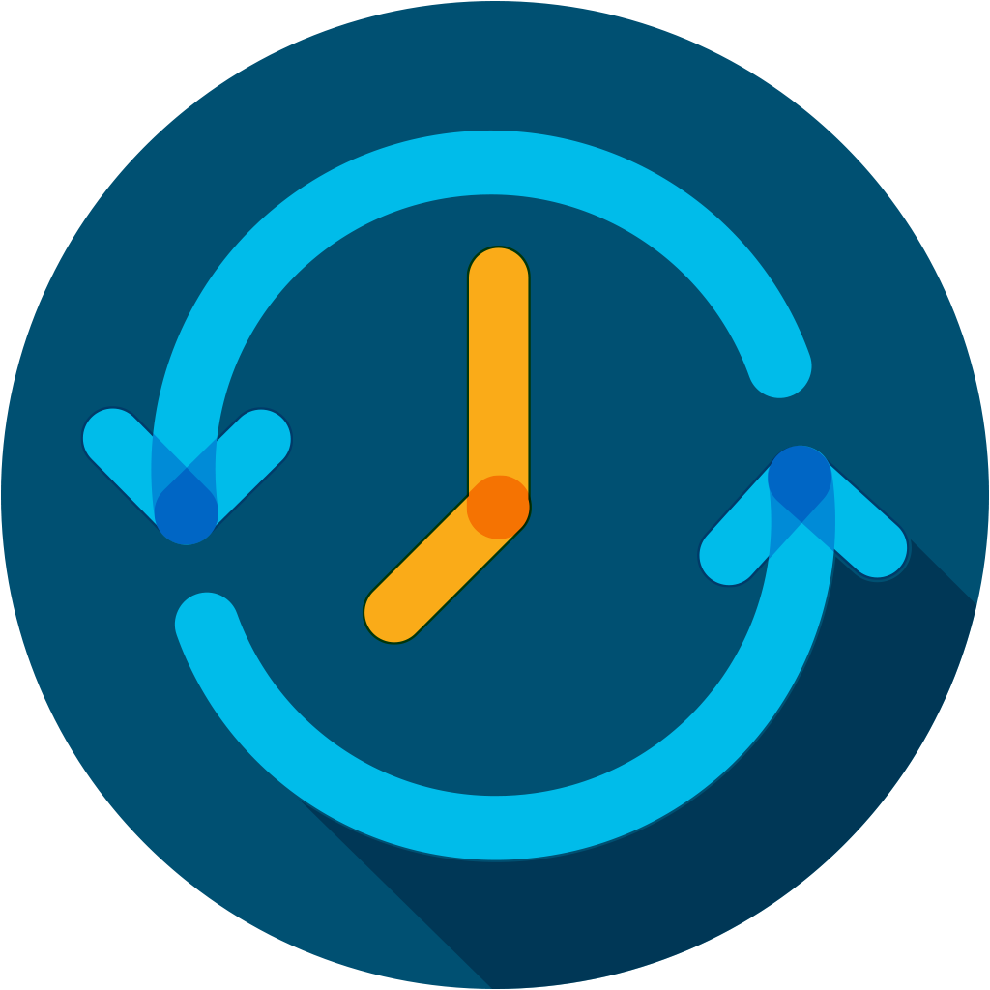

They needed a solution that was…
Operationally simple, easy to mange,
fast, scalable and provided an APP
friendly environment
1000’s of APPs – Micro segmentation
is a key requirement

Slide 44
Evolutionary path to hybrid cloud solutions
Nexus 9000 + ACI Provided + Tetration
Self service DC solution that will provide an on demand consumption model
Integrated network approach - > physical + virtual
Superior programmable, secure and automated environment
Micro-segmentation – deliver scalable and secure apps
Openness allowed to integrate with other vendor products
Deep visibility, learn application behavior and plan confidently for the future
LOB’s perceived IT as a roadblock
IT key for business transformation

Slide 45
Compliance
Assure network security policies and maintain SLAs

Slide 46
DC paradigms
are fundamentally reactive

Slide 47
Intent frequently breaks …
We always react …
Operational
Troubleshoot
Security
Scramble to fix it
Compliance
Fail audits
Change
Undo changes

Slide 48
An inability to assure intent proactively
Leaving us with …
...Creating a major assurance gap
How do I have confidence that I don’t have errors due to
my changes?
How do I easily understand
the state of my entire infrastructure?
How do I rapidly analyze the network to identify issues?

Slide 49
Assurance
The confidence that the infrastructure
is doing what you
intended it to do
Intent encompasses data center operations
Configs, Changes, Routing, VMs, Security, … Compliance, Audits
Notes:
What we need is the ability to assure intent. It is a guarantee, the confidence that the infrastructure is doing exactly what you intended it to do
That your changes and config are correct and consistent
That the forwarding state has not drifted to a something bad
That VMs deployment and movement hasn’t broken your reachability intent
Or your security policies are achieving the segmentation goals per intent
That they are always compliant with business rules and you can pass audits easily

Slide 50

Cisco network assurance engine
Based on mathematical models of the network
Comprehensive, intelligent, continuous
Continuously verifies and validates the entire network
Proactively delivers the confidence that the network is operating correctly
Notes:
That’s what we are bringing to the market with Cisco Network Assurance Engine.
It’s a whole new way to solving this problem
It starts with building mathematically precise models of the network ---- For instance, we pick all your security contracts, represent them in a software model. Now you can ask that model all sorts of questions – can A talk to B, is A isolated, do we have any conflicting policies out of 1000s or millions of policies, and so on. We build models spanning security, forwarding, end-point configs, hardware resource utilization, policies etc. and This is the most comprehensive model of the network
We didn’t stop there. We then codified1000s of failure scenarios right out of the box, that run against these models – continuously verify and validate the entire network. These checks are based on our experience of how networks should correctly operate, best design practices from our AS teams, and the collective knowledge we have across TAC cases from 1000s of customers. These failure scenarios run against the real-time models, continuously checking the network for correctness.
That’s whats gives the operators the confidence that the network is indeed operating consistent with their intent. And here’s the key point – We can do this without needing to look at any packets – we build our models with all the configurations and dynamic state! And that make it’s fundamentally proactive, before any data traffic even enters the network.
The product is AVAILABLE NOW. It is delivered in an entirely software form factor.

Slide 51



Industries highly secure network
For internal use only
Highest level of security.
US military
Common criteria
Federal information
processing
Cisco Nexus and ACI certified for US military deployment meeting the highest security standards by meeting the stringent UC APL requirements
The Cisco Nexus 9000 Switches in ACI mode, APIC and Nexus 2000 Fabric extenders achieved Common Criteria certification
Nexus 9000 and ACI achieved FIPS Certified designation. U.S. government procurement, all solutions that use cryptography must complete FIPS
140-2 validation to ensure end users receive a high degree of security, assurance, and dependability
Only vendor with all 3 security certification in the DC

Slide 52
Industries highly secure network
For External use only
Highest level of security.
US military
Common criteria
Federal information
processing
UC APL
Common Criteria
Fips Cryptography
Cisco Nexus and ACI certified for US military deployment meeting the highest security standards by meeting the stringent UC APL requirements
The Cisco Nexus 9000 Switches in ACI mode, APIC and Nexus 2000 Fabric extenders achieved Common Criteria certification
Nexus 9000 and ACI achieved FIPS Certified designation. U.S. government procurement, all solutions that use cryptography must complete FIPS
140-2 validation to ensure end users receive a high degree of security, assurance, and dependability
Only vendor with all 3 security certification in the DC

Slide 53
Investment Protection
Future proofing for the next decade

Slide 54
Invest for the future
2018
Traditional data center
Cloud ready data center
CAPEX:
optics, backward compatibility etc. …
Multi Cloud
Hybrid Cloud
Policy Driven Automation
ITaaAS
PaaS
SaaS
XaaS
Flexible consumption models
(on premise, cloud, licensing)
Virtualization
Traditional Data Center

Slide 55
400G invest for the future
Backwards compatibility
Lower cost
Design flexibility
Investment protection
Priority with wide range of customers including cloud customers
Optics cost is becoming a barrier to transition
Industry experience with proven form factor
Cabling infrastructure is an expensive and cumbersome process
QSFP-DD positively checks out on all the components necessary for an optic to succeed in your data center
Compatibility
Investment protection
System density
Superior performance

Slide 56
Nexus software subscription benefits
Subscription offers
Cisco ONE
Storage, Security, NDB (NX-OS)
Add-Ons
Benefits of data center subscription
Advantage
Latest innovations through simple subscription tiers
Manage one or more data centers
Run in ACI or
NX-OS mode
Investment protection
ACI Multi Site
Remote Leaf
VPN Fabric
New Offer
Essentials
Ability to tailor investment to specific data center landscape
Flexibility to migrate to policy-driven ACI when convenient
Investment value grows through innovation and updates
ACI base
ACI multi-pod
telemetry
layer 3 routing
Fabric management
PTP
network services
Cisco ONE advantage
Cisco ONE essentials
Nexus 9K + switch software
(for chosen mode, ACI or NX-OS)

Slide 57
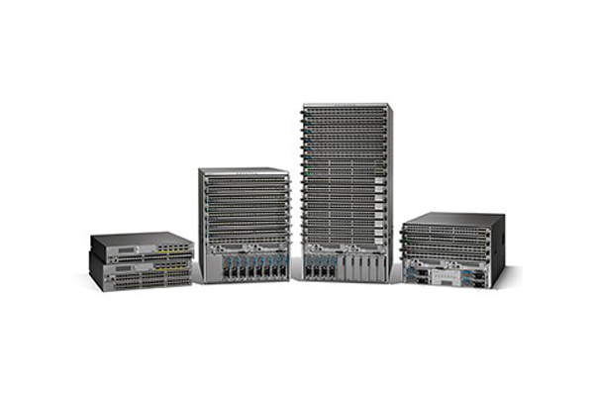
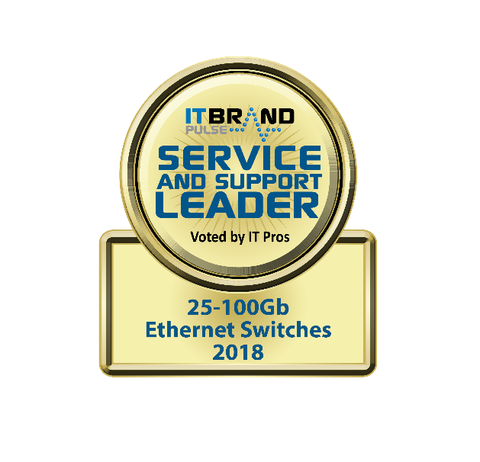
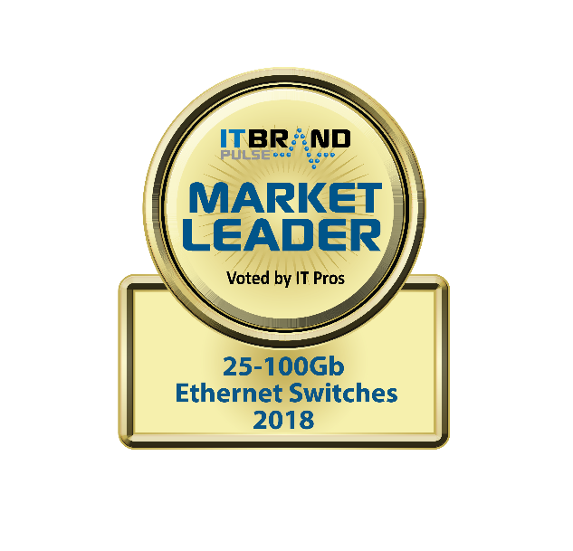
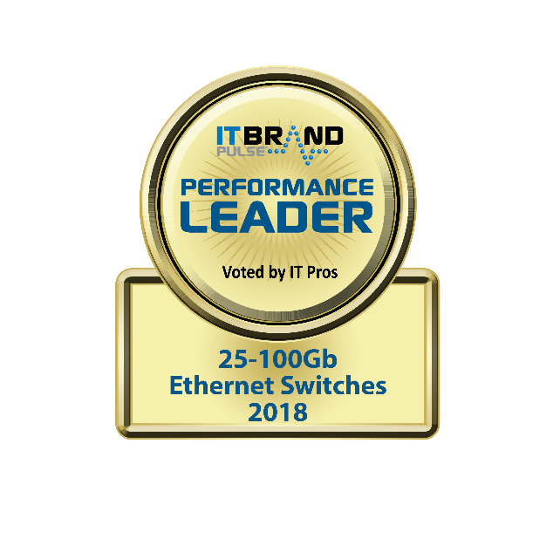
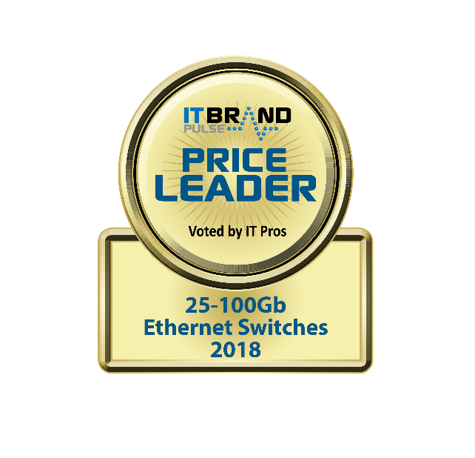
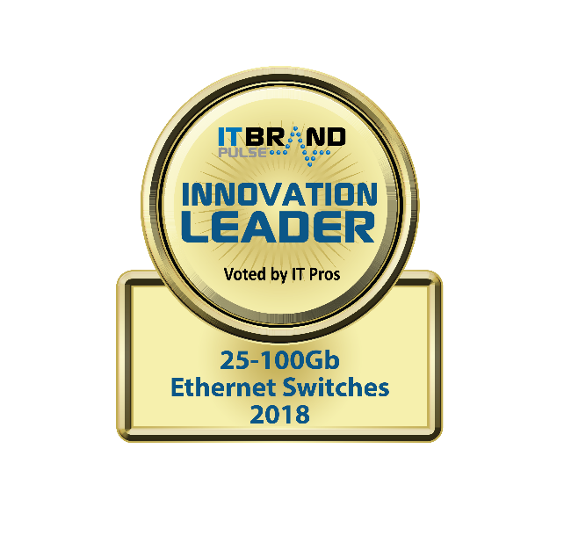

Industry recognition

Slide 58
Key takeaways
Speed
Simplicity
Visibility
Assurance and compliance
Investment protection
Best of Breed Switching - Cloud Scale ASIC
Industry leading programmability – Open NX-OS capabilities. Industry leading DC network automation – ACI with policy based automation
Industry leading Analytics – Built in Tetration sensors for data plane analytics and streaming telemetry for control plane analytics
the confidence that the infrastructure is doing exactly what you intended it to do
Future ready: 400G, innovations, ASIC etc

