Slide 1
Cisco SD-WAN
Connect any user to any application without compromise
October 2019

Slide 2




Viptela Leads SD-WAN Transition in 2013
Applications
Public
MPLS/
Internet
Branch/Campus
Private
Data Center
Internet extends to branch edge
Applications moving to cloud
Primary Objective: More branch bandwidth and lower WAN costs

Slide 3









Today Applications are Moving to Multiple Clouds
Devices & Things
DC/Private Cloud
WAN
Campus & Branch Users
SaaS
Mobile Users
IaaS

Slide 4
Internet Connectivity Becomes Business Critical
Campus
X2-5
DC/Private Cloud
Branches X100+
Exposure to cyber threats
Inconsistent user experience
SaaS
Increasing complexity
Mobile
Users
X1000s
IaaS
More users, things and applications, everywhere
Notes:
Businesses view the Cloud as a key part of their strategy and innovation.
The larger the business, the More users, devices, things that are consuming applications from multiple different clouds.
As the pace of business increases this results in a highly complex and dynamic network.
The preferred method of connecting users to applications is shifting from dedicated MPLS connectivity to using the internet.
As a result Internet connectivity becomes business critical.

Slide 5
To help, IT is deploying SD-WAN
2018 Analyst Definition*
Branch router/CPE functionality
Operate autonomously during loss
of connection to controller
Summary of Basic
SD-WAN Capabilities
Support Hub & Spoke, Partial/Full Mesh
Centralized management:
Inventory, visibility, reporting, Management, config changes, SW upgrades via GUI
Circuit Load Balancing
Direct Internet Access
Centralized Management & Orchestration
Lower Circuit Costs
Zero-touch configuration
VPN (AES 256-bit encryption)
Direct Internet Access
Dynamic traffic steering based
on business or application policy
Support for traffic shaping and QoS
>100 well-known application profiles included + custom template capabilities
Self-serve granular configuration changes
*Gartner Critical Capabilities for WAN Edge Infrastructure, December 2018

Slide 6




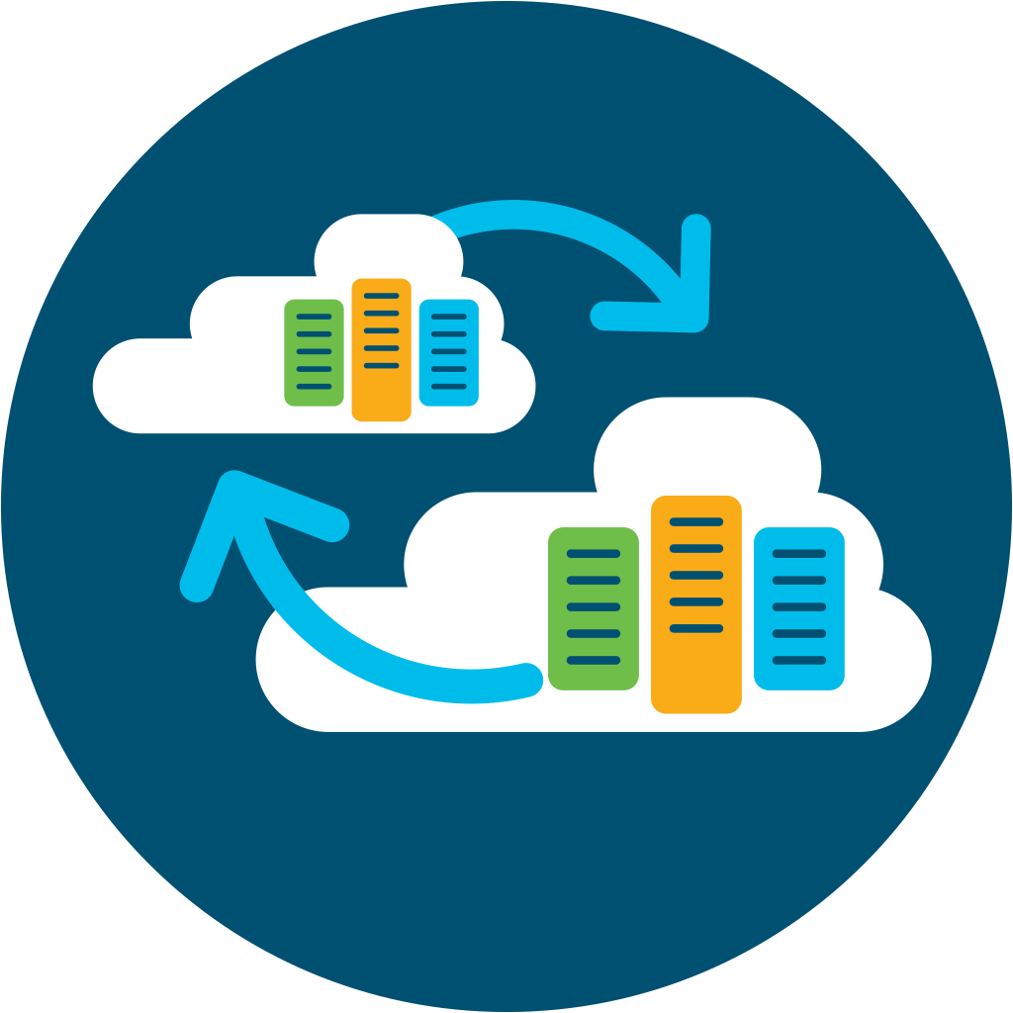
Introducing Cisco SD-WAN
Powered by Viptela
Cisco SD-WAN extended capabilities
Basic SD-WAN*
Multi-layered Security
Summary of Basic
SD-WAN Capabilities*
Circuit Load Balancing
Direct Internet Access
Centralized Management & Orchestration
Circuit Cost Savings
Security & Segmentation
Analytics &
Visibility
Circuit Load Balancing
Direct Internet Access
Centralized Management & Orchestration
Circuit Cost Savings
Application Optimization
Voice
Optimization
SaaS/IaaS Optimization
App Aware
Dynamic Routing
Enterprise Scale
Open and Programmable
Multi-Tenant/
Multi-Domain
*Gartner Critical Capabilities for WAN Edge Infrastructure, December 2018
Notes:
”Basic SD-WAN” is:
FEC
Transport Independence
Hub-Spoke, Mesh
Circuit Load Balancing
Centralized Orchestration
Branch office router/CPE functionality
Operate autonomously during loss of connection to controller
Support for: Hub & Spoke, Partial/Full Mesh
Centralized management:
- Inventory, visibility, reporting & config changes, SW upgrades
- Management, configuration via GUI
Zero-touch configuration for branch devices
VPN (AES 256-bit encryption)
Direct Internet Access
Dynamic traffic steering based on business or application policy
Support for traffic shaping and QoS
> 100 well-known application profiles included + custom template capabilities
Self-serve granular configuration changes

Slide 7

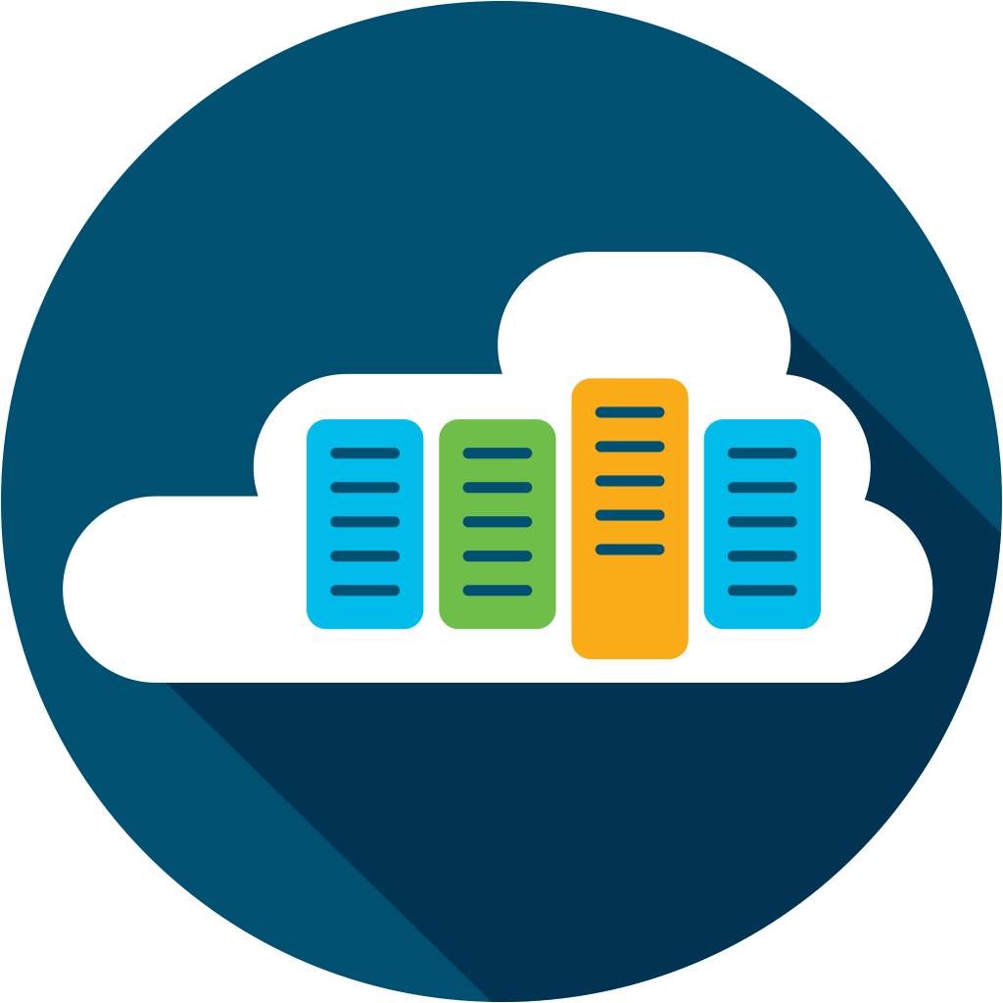
Secure Cloud Scale SD-WAN Architecture
vManage
On-premise | Cloud | Multi-tenant
Any Deployment
Automation | Network Insights | Analytics
Open | Programmable | Scalable
Any Service
Branch Security
Cloud Security
Application Quality of Experience
Voice and Collaboration
Cloud
OnRamp
Any Transport
5G/LTE
Satellite
Internet
MPLS
Any Location
Branch
Colocation
Cloud
GCP
AWS
Azure

Slide 8




Benefits of Cisco SD-WAN
Predictable app experience
Right security, right place
Enterprise grade, simplified
Support for evolving business application strategy
Cloud OnRamp for IaaS, SaaS and Colocation
Secure segmentation across entire network stack
Full edge security stack from branch to cloud and colocations
Intent-based networking with multi-domain policy
Proven deployments to over 10,000+ sites
One user interface for Security and SD-WAN across branch, cloud, and co-location

Slide 9




Business Value of Cisco SD-WAN
38%
58%
94%
Lower five-year cost of WAN operations
Faster to implement policy/ configuration changes
Less unplanned downtime
Full IDC report available on www.cisco.com/go/sdwan
$14.98M increased revenue per organization
Notes:
1st middle
58% 2nd
^{3rd 94% and 14.98}

Slide 10
Use cases for delivering a predictable application experience

Slide 11





Why Backhauling Impacts Application Performance
SaaS
Single Path to Internet
Datacenter
Colocation provider
Cloud security provider
Data Center
Branch/Campus
Corporate
Software
Users
SD-WAN Fabric
Colocation
Provider
Cloud Security
Provider
A single path for all mission critical business applications
Notes:
Today, backhauling traffic that is internet bound impacts SaaS performance.
If you only have a single path for all of you internet bound traffic then you will see impact to application performance as all internet bound traffic competes for the same bandwidth.
That single path could be through:
Your data center
A cloud security provider (the added downside here is that if the cloud security provider goes down then your network will be down as well. The same applies to Microsoft Virtual WAN where all traffic (even non Microsoft traffic) is being sent to a single provider and in addition to the extra latency this creates it is also a single point of failure).
A colocation provider that is providing your internet access.

Slide 12
Improving Application Experience
Internet
IaaS/SaaS
Capabilities
FEC Header
FEC Header
1
2
FEC Header
3
Application SLA
TCP Optimization
Forward Error Correction
Pack Duplication
FEC Header
FEC Header
P
4
TCP
Internet
(Secondary)
Optimized
TCP Connection (Cubic)
Internet
Internet
Data Center
1
2
1
4
3
Branch/Campus
2
Parity
Path 1
2
App
A
4
3
1
3
44
MPLS
4
Path 2
1
3
2
Path 3
4
2
1
MPLS
(Primary)
4G LTE
MPLS
App Aware Routing Policy
App A path must have
latency <150ms & loss <2%
Path1: 10ms, 0% loss
Path2: 200ms, 3% loss
Path3: 140ms, 1% loss

Slide 13
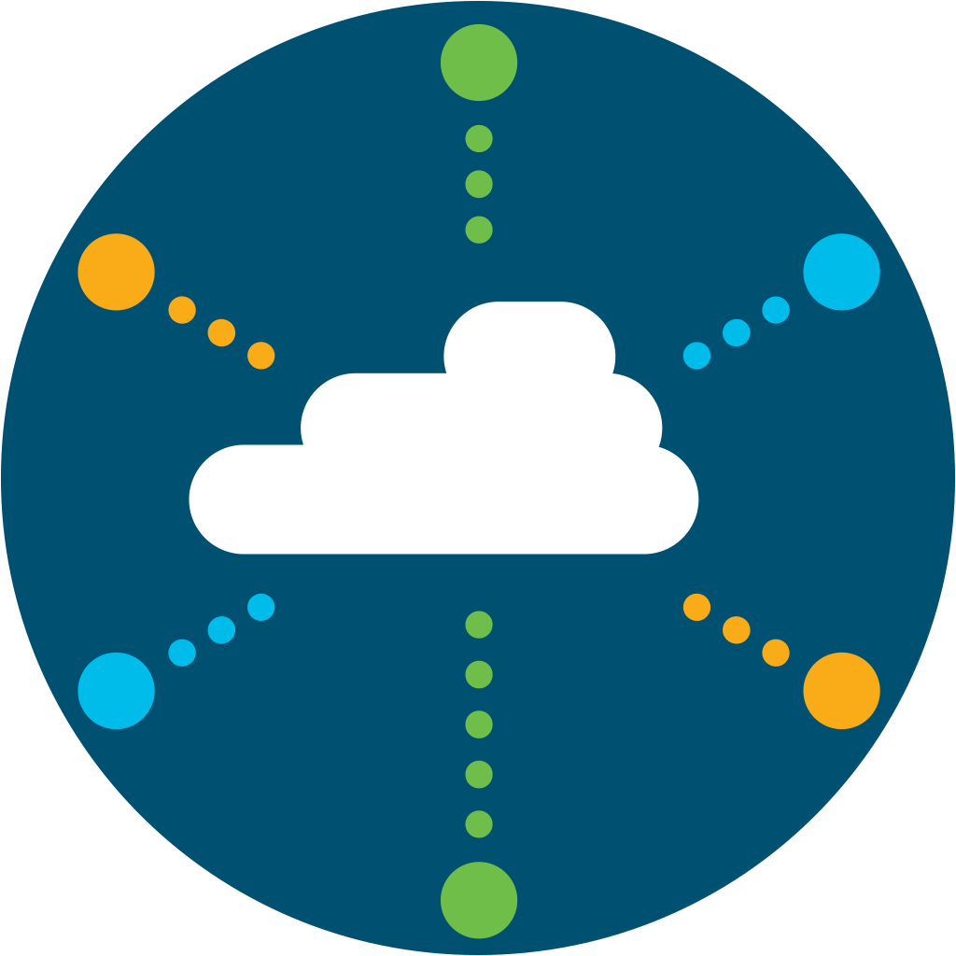
SaaS Optimization
SaaS
Optimization via Multipath
Up to 40% faster Office 365 Performance
Data Center
Branch/Campus
Corporate
Software
Users
SD-WAN Fabric
Colocation
Provider
Cisco
SD-WAN
Cloud Security
Provider
Increased reliability and utilization of best path for SaaS applications
Notes:
Today Cisco SD-WAN (Viptela) has a feature called OnRamp that can optimize 13 SaaS applications: https://sdwan-docs.cisco.com/Product_Documentation/Software_Features/Release_18.3/Network_Optimization/Using_Cloud_OnRamp_for_SaaS
Cisco SD-WAN makes it easy for IT to optimize SaaS application performance. We do 3 things:
With OnRamp we make it easy for IT to connect to SaaS applications with simplified workflows within Cisco vManage
vManage continuously measures the performance of a SaaS application through all available paths from the user to the cloud and will always select the best path that delivers the best user experience.
By monitoring all available paths Cisco SD-WAN OnRamp not only provides the best performance it also increases availability (and productivity) for users since it will find alternative paths if a failure occurs.
In the case of Office 365 Cisco has worked closely with Microsoft to add new capabilities so that Cisco SD-WAN is now able to easily identify the closest Office 365 data center to the user that will deliver the best performance.
This score gives network administrators visibility into application performance that has never before been available. Most importantly, the fabric automatically makes real-time decisions to choose the best-performing path between the end users at a remote branch and the cloud SaaS application. Enterprises have the flexibility to deploy this capability in multiple ways, according to their business needs and security requirements.
To achieve this 40% number we did the following:
We did this the tests by simulating a Data center in AWS Mumbai region and a remote branch in AWS Sydney region.
We did download/upload tests to and from one-drive (Office 365) using a 233MB file and recorded the transfer times with and without the feature enabled. We observed up to 40% improvement in file transfer times with the feature enabled. We also did tests using Skype network assessment tool published my Microsoft and also observed better round trip times with the solution enabled.

Slide 14


Extended SD-WAN to IaaS
VPC
VPC
VNet
VNet
Cloud onRamp to IaaS
VPC
VPC
VNet
VNet
VPC
VPC
VNet
VNet
VPC
VPC
VNet
VNet
Transit
Hub
Transit
Hub
Cisco WAN Edges deployed in a Transit Hub, acting as virtual aggregation routers
Partial extension of SD-WAN Fabric
Automated deployment process with vManage
SD-WAN Fabric
SD-WAN Fabric
vManage
vManage
Branch
Branch
Internet connection
to IaaS cloud
Connect to IaaS cloud
via co-location

Slide 15
Use cases for deploying the right security in the right place

Slide 16
How SD-WAN exposes new security challenges
Internal & External Threats
Internet
IaaS/SaaS
External
Exposure to malware & phishing due to direct internet and cloud access
Data breaches
Guest access liability
Internal
Untrusted access (malicious insider)
Compliance (PCI, HIPPA, GDPR)
Lateral movements (breach propagation)
NO SECURITY
Data Center
Branch/Campus
Corporate
Software
BASIC/NO SECURITY
Users
SD-WAN Fabric
WAN Edge Device
Existing Security Stack in DMZ
Notes:
So SD-WAN with its direct Internet access capability exposes branch & remote locations plus IaaS to some security risks.
Network teams must balance security against both external and internal threats exposed by SD-WAN with user experience, cost, and complexity:
External Threats: Direct cloud connectivity presents a greater level of exposure to malware and other internet-borne threats for branch, IaaS, and remote locations. Examples: unauthorized access, data breaches, malware infections, phishing attacks.
Internal Threats: Public internet transport exposes your apps & databases to internal threats that move laterally between your branches, DCs or IaaS gaining untrusted access or subject to compliance rules.
To secure SD-WAN, three security approaches are typically considered:
<click>

Slide 17
Benefits with integrated security everywhere
 | PRO | CON
ONLY Cloud Security | Consistent user and device protection in all locations and scales on-demand | Lacks visibility and control over internal traffic and threats
ONLY On-Prem Security | Visibility into all traffic and protects against internal and external threats | Decrypting traffic for malware detection increases edge device footprint
On-Prem & Cloud Security | Best balance of security and user experience for direct internet access | Complex & costly to deploy and manage using different solutions or vendors
 | PRO | CON
ONLY Cloud Security | Consistent user and device protection in all locations and scales on-demand | Lacks visibility and control over internal traffic and threats
ONLY On-Prem Security | Visibility into all traffic and protects against internal and external threats | Decrypting traffic for malware detection increases edge device footprint
On-Prem and Cloud Security | Best balance of security and user experience for direct internet access | Cisco integrated solution eliminates these cons
Internet
IaaS/SaaS
Internet
IaaS/SaaS
Data Center
Branch/Campus
Data Center
Branch/Campus
Corporate
Software
Corporate
Software
Users
Users
SD-WAN Fabric
SD-WAN Fabric
WAN
Edge Device
Existing Security
Stack in DMZ
Separate
Security Appliance
Separate Cloud
Security Service
Cisco SD-WAN
Notes:
Deploying cloud security services between the branch and Internet is this first approach. This has several advantages such as:
Consistent user and device protection in both branch and remote locations against all external threats.
No impact to network performance and user experience when decrypting SSL/TLS traffic—even as bandwidth increases. On demand scalability is most cost efficient, especially with a larger number of branches.
A major disadvantage of ONLY sending traffic thru cloud security service is:
No visibility into inbound traffic to, or internal traffic across, branches, DCs and IaaS and no internal threat detection or traffic segmentation
<click>
The second approach is deploying UTM (Unified Threat Management) on-premises to address direct internet access (DIA).
This way has the following advantages:
Protects users and devices from any external and internal threat in your branch locations.
Great visibility, threat detection and traffic segmentation between branches and DCs.
But the major disadvantages of ONLY deploying on-prem security is:
On-prem TLS/SSL decryption increases the edge device footprint. Without sufficient or scalable decryption resources, user experience can be impacted.
Managing threat detection and traffic segmentation in separate solutions adds complexity, plus costs increase based on the number of branches.
<click>
Adding security everywhere is the most complete but traditionally challenging approach. While users can always take the fastest path to the cloud, having different security solutions introduces more complexity. It will be very difficult to manage all those security solutions especially if you are using solutions from different vendors. However, Cisco has solved this third security approach of applying security everywhere without the complexity!
<click>
Cisco has solved this third security approach of applying security everywhere without the complexity!
Only Cisco SD-WAN offers an integrated on-prem and cloud security solution that provides a full edge security stack for all connections from branch to Internet/SaaS and to DCs/IaaS.
<click>

Slide 18
Deploying Cisco SD-WAN Security
Full Edge Security Stack
Internet
IaaS/SaaS
On-Prem Security
Mitigate Internal & External Threats
Cloud
Security
Mitigate External Threats at Scale
Data Center
Branch/Campus
Corporate
Software
Users
Enterprise firewall and intrusion prevention embedded for internal threats plus URL filtering and malware sandboxing for external threats
End-to-end segmentation to stop breach propagation, enforce regulatory compliance, and promote network (and application) layer security
Zero-trust authentication and full payload encryption between edge routers
Integrated connectivity and cloud-delivered security with 100% business uptime
Secure Internet Gateway protects users and devices and protects data sent to and from the cloud
SD-WAN Fabric
Single Management Console
Notes:
Only Cisco SD-WAN offers an integrated on-prem and cloud security solution that provides a full edge security stack for all connections from branch to Internet/SaaS and to DCs/IaaS.
Cisco SD-WAN edge devices integrate connectivity and on-prem security, providing end-to-end WAN access security against internal threats. Concurrently, the edge devices integrate connectivity and cloud security, providing a secure internet gateway against external threats.
No need to compromise on security, user experience, or performance. Gain the advantages of both on-prem security and cloud security without their disadvantages:
Improve end-user experience by securing direct internet and cloud access
Ensure performance through cloud-based SSL/TLS traffic decryption
Get comprehensive visibility and control on all inbound and outbound traffic
Reduce costs and complexity by providing one box for networking, security, and cloud.
Only Cisco SD-WAN offers comprehensive Gartner defined security categories spanning both on-prem and cloud security. These categories are: Network Segmentation’, ‘Enterprise Firewall’, ‘Secure Web Gateway’, ‘DNS-Layer Security’
The specific capabilities which span multiple market categories are: ‘IPsec Encryption’, ‘IPS’, ‘App Controls’, ‘TLS/SSL Decryption’, ‘Malware Protection’, ‘URL Filtering’
<click>
For On-prem security, we provide enterprise firewall with application control and Talos-Powered IPS to defend against internal threats and URL filtering and malware protection and file sandboxing to defend against External threats.
We also provide segmentation policy based on device type, application characteristics, network topologies, and user locations and profiles to simplify the provisioning of network access.
And we ensure the privacy of traffic crossing the network by all devices being fully and securely authenticated with 2048-bit encryption keys.
<click>
As for cloud security side we:
Quickly deploy DNS-layer security to block internet destinations hosting threats or policy violations
Shift firewalling controls from hardware to software as a service to enforce IP, port, and protocol rules to give customers the option to deploy in the cloud instead of on-prem
Check for malware and policy violations in all web and SaaS traffic with decryption that scales for future traffic growth

Slide 19
Use cases for needing enterprise grade functionality, simplified

Slide 20

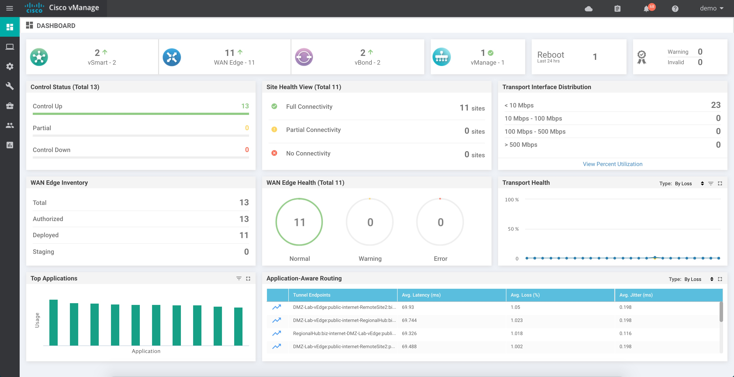
SD-WAN Management
Cisco vManage
Single Monitoring Dashboard
Configuration: OnRamp, Security, Devices, Policies, Templates
Lifecycle management
Role based access/
Multi-tenant
One management dashboard for branch, co-location, cloud and Security
Notes:
Through Cisco vManage (Viptela cloud management user interface) Cisco is able to provide One console for SD-WAN and network security to help simplify management

Slide 21
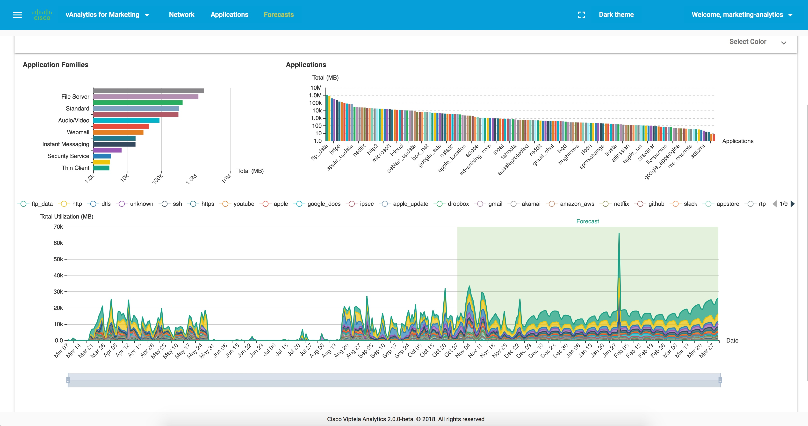
SD-WAN Analytics
Real-Time Information
Future planning and what-if scenarios
Recommendations for predictable app performance
Benchmarking
Cisco vAnalytics
Notes:
An additional feature is Cisco SD-WAN vAnalytics.
vAnalytics provides us with these benefits for the WAN network:
Provides real-time information for failure correlation, cross customer benchmarking, and App perf scores
Enables future planning based on intelligent data (App / bandwidth forecasting, branch expansion analysis, policy changes what-if)
Recommendations for App QoS categorization and policy changes for predictable App performance

Slide 22
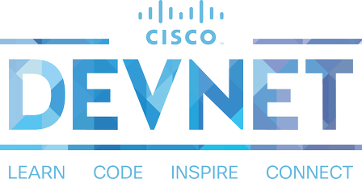
Cisco SD-WAN is Open and Programmable
Enterprises
Managed Services
OSS/BSS Integration
Multi-Tenant
Learning and
hands-on content
Sandbox
Partners
Code Exchange
Dev Center
Ecosystem Exchange
Notes:
In a world of proprietary and closed SD-WAN solutions, Cisco SD-WAN is Open and Programmable.
Viptela designed API’s into its platform from the start and with this announcement we are making those API’s available to everyone through Cisco DevNet.
Key benefits include:
With open APIs, Cisco SD-WAN provides service providers and partners the opportunity to create new and unique services including Operational/Business Support Systems.
Learn how to access the available REST APIs, create API calls, obtain device and interface information using code, pass parameters and write applications and work on innovative solutions.
As part of the SD-WAN developer resources availability and learning content, there are two additional resources available that are a great value add for developers:
DevNet Ecosystem Exchange makes it easy to find and share an application or solution built for Cisco platforms. Business leaders and developers alike can use this online portal to discover partner solutions that span all Cisco platforms and products. Currently, this one-stop-shop for developers contains over 1,300 solutions.
DevNet Code Exchange gives developers a place to access and share software to quickly build next-generation applications and workflow integrations. A curated list of sample code, adaptors, tools, and SDKs available on GitHub and written by Cisco and the DevNet community, Code Exchange spans Cisco’s entire portfolio and is organized according to Cisco platform and product areas.

Slide 23
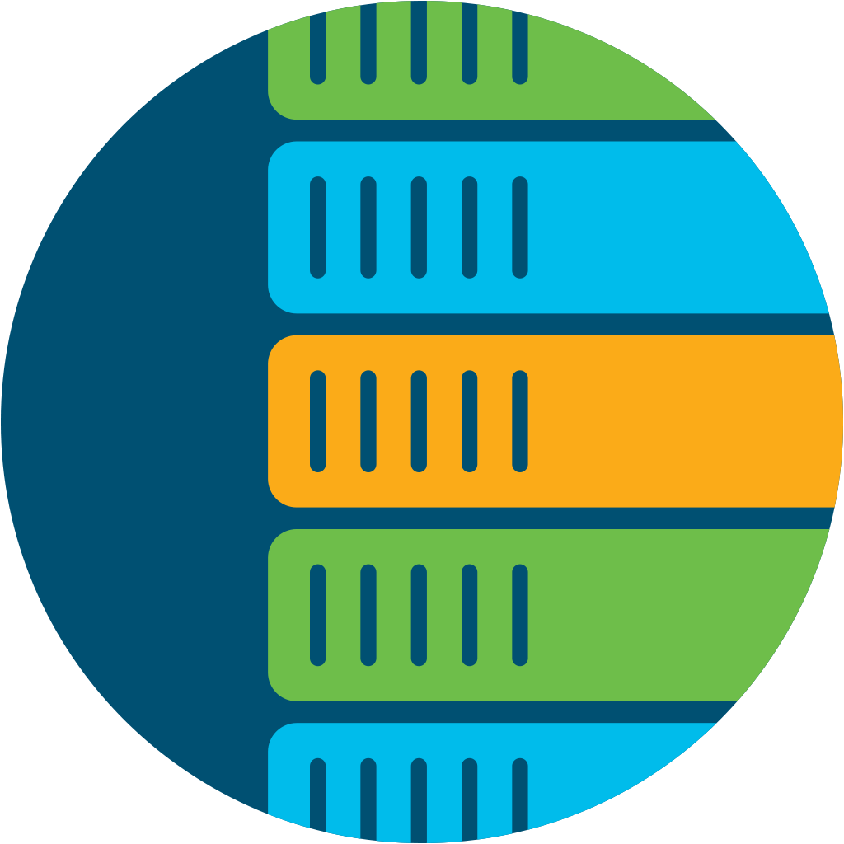
Interconnecting Multi-Domain Networks
SD-Access
Cisco DNA Center
SD-WAN
Cisco vManage
ACI
Cisco APIC
Users (Consumers)
API Integration
API Integration
Applications (Providers)
Users & Devices
Identify and onboard everything
Authenticate and authorized access
Hybrid Cloud
Application experience
Secure internet and cloud access
Data & Applications
Automate resources and workloads
Prevent data breaches
Vertical Integrated Solutions
Notes:
we already have cross domain management and functionality with Meraki, this is how we’re bringing it to Viptela-powered by SD-WAN

Slide 24
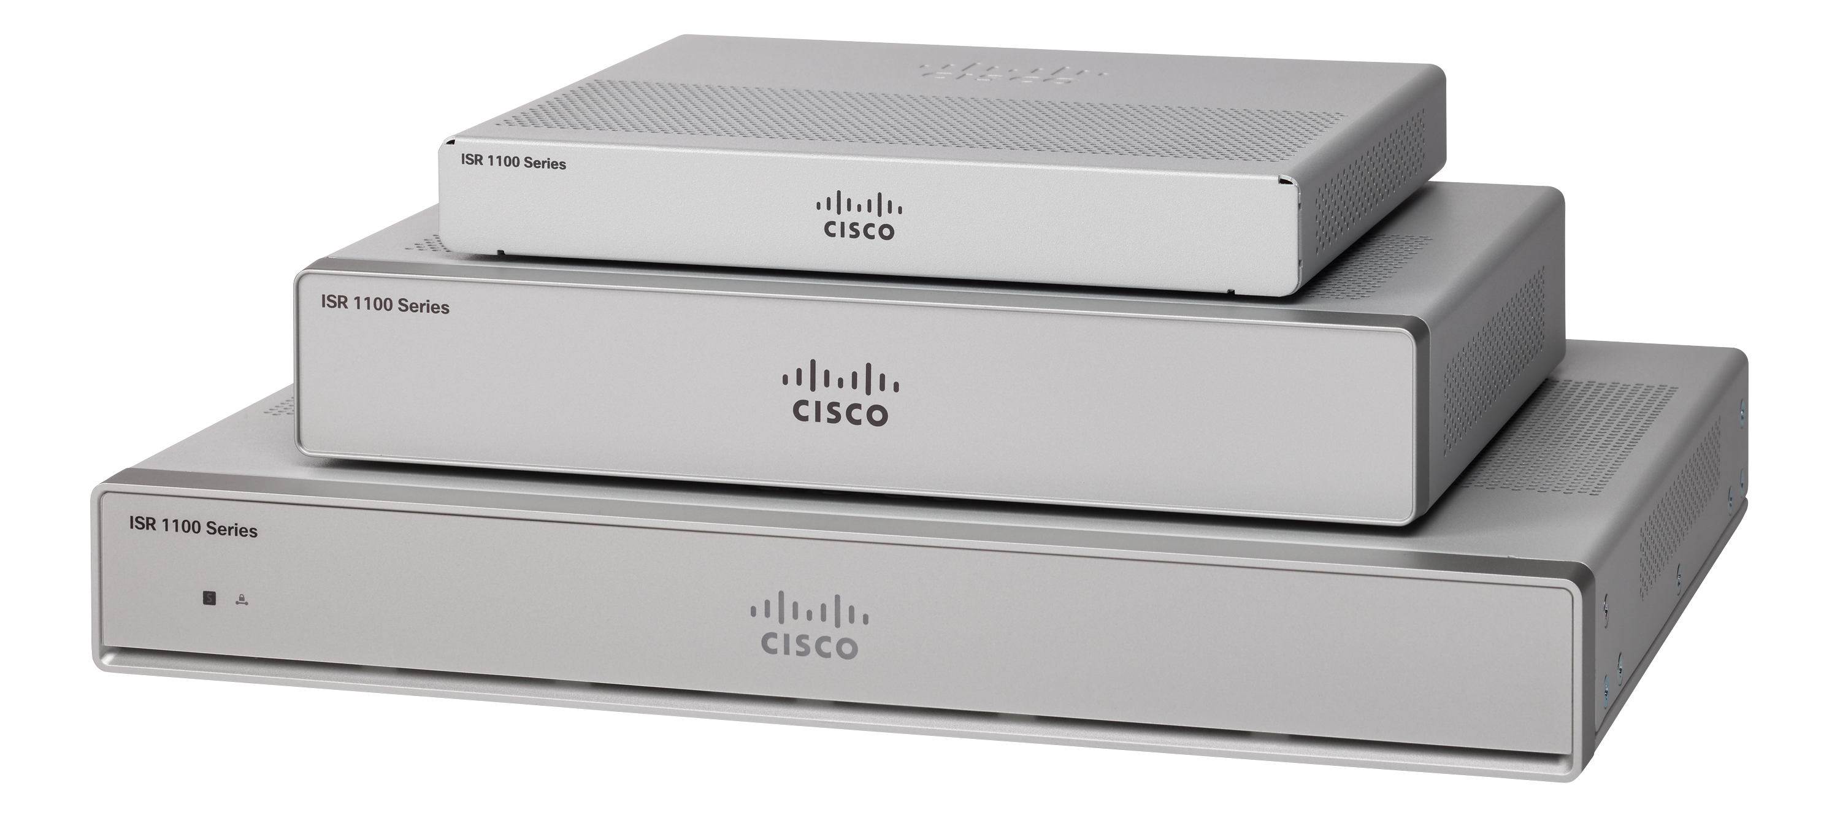
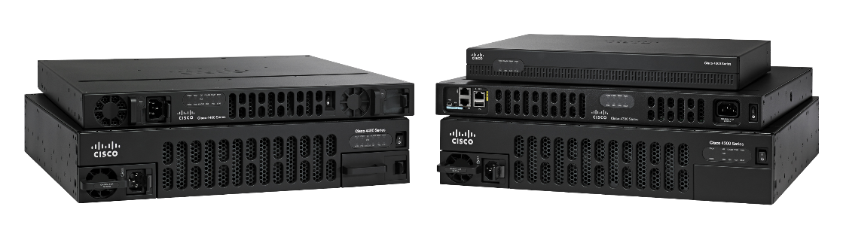
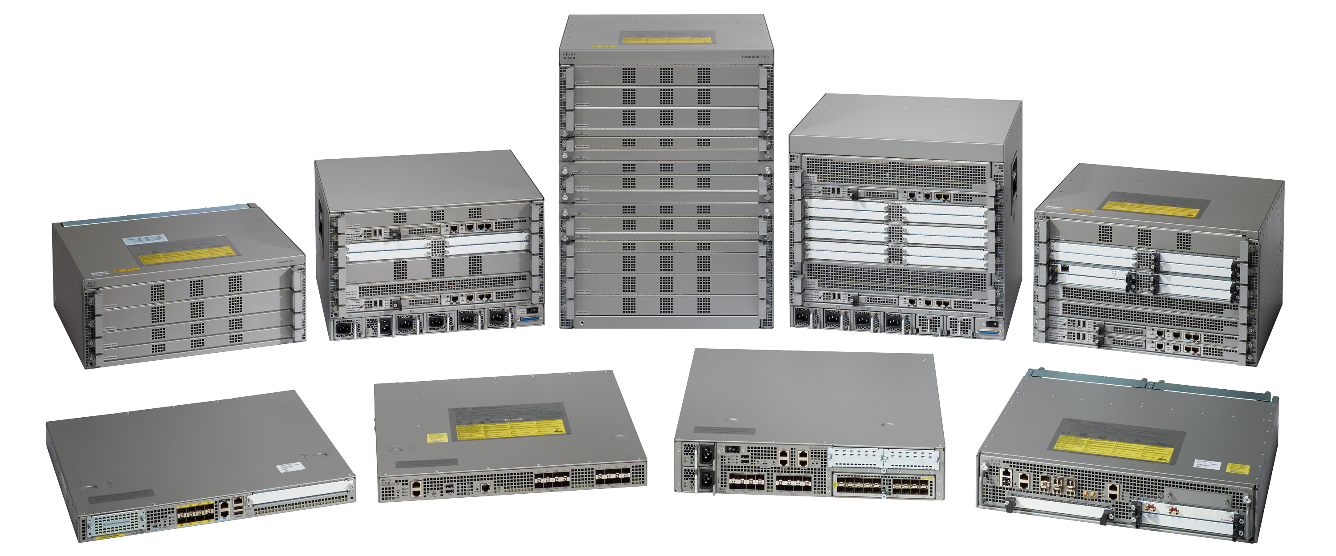

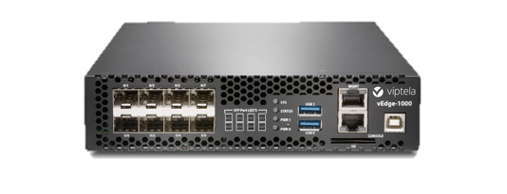
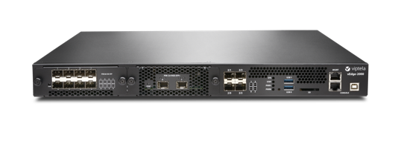
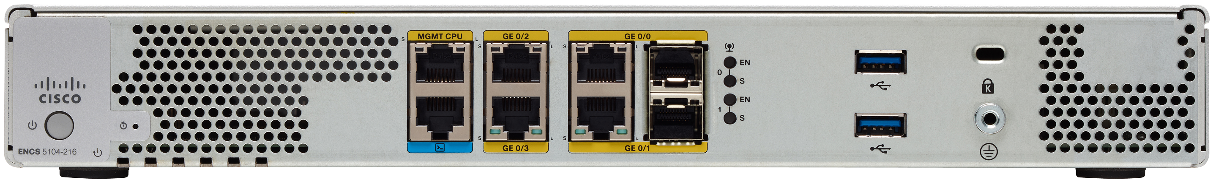
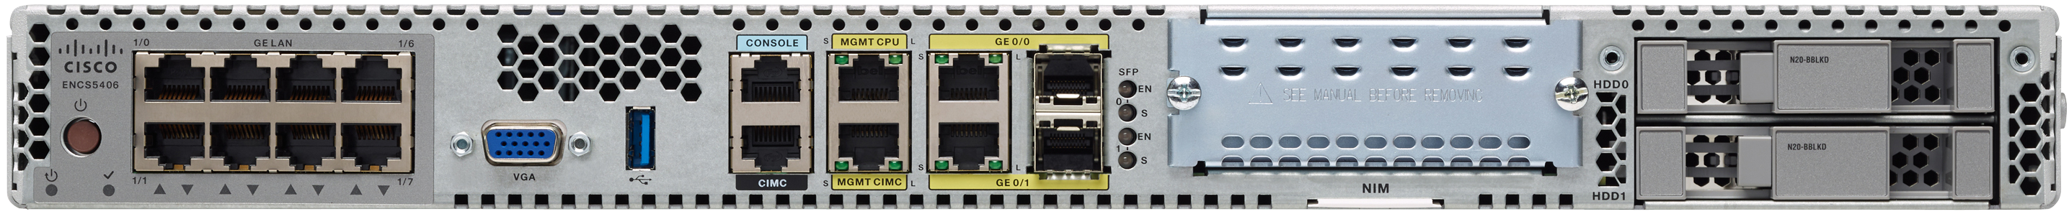


Broadest Set of SD-WAN Platforms
Branch Services
vEdge Appliances
ISR 1000
200 Mbps
Next-gen connectivity
Performance flexibility
ISR 4000
Up to 2Gbps
Modular
Integrated service containers
Compute with UCS E
ASR 1000
2.5-200Gbps
High-performance service w hardware assits
Hardware & software redundancy
vEdge 100
100Mbps
4G LTE & Wireless
vEdge 1000
Up to 1Gbps
Fixed
vEdge 2000
10Gbps
Modular
vEdge 5000
~30Gbps
Modular
Virtualization
Public Cloud
ENCS 5100
Up to 250Mbps
ENCS 5400
Up to 250Mbps
Notes:
Today, backhauling traffic that is internet bound impacts SaaS performance.
If you only have a single path for all of you internet bound traffic then you will see impact to application performance as all internet bound traffic competes for the same bandwidth.
That single path could be through:
Your data center
A cloud security provider (the added downside here is that if the cloud security provider goes down then your network will be down as well. The same applies to Microsoft Virtual WAN where all traffic (even non Microsoft traffic) is being sent to a single provider and in addition to the extra latency this creates it is also a single point of failure).
A colocation provider that is providing your internet access.

Slide 25
Cisco DNA SD-WAN Licensing
Use Case Based Packaging
Cisco DNA Essentials
Cisco DNA Advantage
Cisco DNA Premier
Simplified management and security protection for the cost-conscious customer
Advanced SD-WAN with enhanced security for feature-rich & valued branch deployment models
Advanced SD-WAN security will mitigate the most sophisticated threats to your business
End to end direct Internet
access security
Visibility and control to defeat direct Internet/cloud access threats
Automated cloud security at scale
Improved application experience
Optimized SaaS application experience
Keep consistent controls and visibility when users roam outside the WAN
Simplify operations
Multi-domain Orchestration
across domains
Basic voice optimization
Enhanced voice optimization
Common SD-WAN architectures
Network analytics and visibility
Up to 50 Device Overlay

Slide 26
Cisco DNA SD-WAN Licensing
Capability Based Packaging
Cisco DNA Essentials
Cisco DNA Advantage
Cisco DNA Premier
Simplified management & security protection for the cost-conscious customer
Advanced SD-WAN with enhanced security for feature-rich & valued branch deployment models
Advanced SD-WAN security will mitigate the most sophisticated threats to your business
Enterprise firewall with Talos-
powered IPS and app controls Cisco Umbrella DNS Monitoring
Cisco AMP with SSL proxy
URL filtering
Cisco Umbrella app discovery
Cisco Umbrella Insights®
Cisco Threat Grid®
Application-based SLA
Basic WAN & path optimizations
Cloud OnRamp for IaaS, SaaS, and Colo AppQoE & WAAS RTU
Single centralized management
console in the cloud or on-prem
Integrated border plus orchestration
for campus, branch & DC
Forward Error Correction (FEC)
Packet duplication
Integrated voice/UC gateways
Flexible topology & dynamic routing (hub/spoke, partial/full mesh)
vAnalytics
Cisco DNA Advantage
Up to 50 Device Overlay
Cisco DNA Essentials
Cisco DNA Essentials

Slide 27














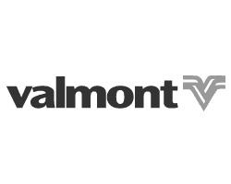









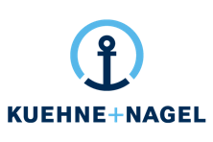






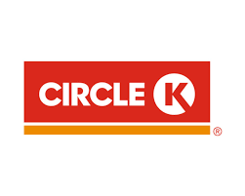







Global Customers Across All Verticals
Finserv
Healthcare/Pharma
Manufacturing
FinServ
Healthcare / Pharma
Manufacturing
Retail
Technology
Other Industries
Retail
Technology
Other Industries
Notes:
Ok to show if under NDA

Slide 28
Fast track to SD-WAN with Cisco Services
  Proven infrastructure simplifies implementation complexity
  Expert technology guidance scales innovation and accelerates results
  Cisco’s experience and best practices reduces risk
SD-WAN quick start service
cisco.com/c/en/us/products/routers/service-listing.html
Fixed price | Predefined scope for design | Implementation and validation
Notes:
Cisco Service makes it easy to get started with SD-WAN.
Cisco services can rapidly deliver simpler projects based on a fixed price ($25K list) limited-scope deployment via the SD-WAN Advise and Implement Quick Start
Accelerate your path to SD-WAN with a predefined project scope and budget including Solution Design, remote Implementation Execution and remote Knowledge Transfer.
Simplify implementation complexity with a predefined project scope, proven infrastructure that can scale when you’re ready.
Scale innovation and accelerate results using predictive steps, state-of-the-art tools, and expert technology guidance.
Reduce risk knowing that you’re building your SD-WAN infrastructure on a solid foundation based on Cisco’s deep experience and best practices gained from countless real-world deployments.
Value of Cisco Services- with proven experience, best practices, and innovative tools, we help you confidently adopt, deploy and manage SD-WAN in a multicloud environment

Slide 29

Why Cisco SD-WAN?
v
Predictable Application Experience
No matter where you applications are hosted Cisco SD-WAN delivers the best user experience, securely across any cloud.
Right Security, Right Place
Protect all users, devices and applications by deploying the right security, on-premise and cloud delivered, in the right place, quickly.
Simplicity at Enterprise Scale
Delivering Intent-based Networking with best of breed technologies across every domain with consistent policy and assurance integration
*Gartner Critical Capabilities for WAN Edge Infrastructure, December 2018

Slide 31
Case Studies

Slide 32

National Instruments
Background
      Needed to improve global network capacity and performance at a lower cost
      Increasing bandwidth and security burden on WAN impacted sales, R&D, manufacturing and contact center globally
      Demand growing 10-25% annually
      Benefits of Cisco SD-WAN
      Optimizes traffic and performance across the WAN
      Traffic distributed over lower-cost Internet connections vs MPLS
      Reduced MPLS spending by 25% while increasing bandwidth 30.75%

Slide 33

Enterprise Case Study
Fortune 500
National Food Distributor
Food distributors play a key role in the food and beverage industry, serving as the intermediary between the manufacturer and their respective retail, restaurant, and foodservice customers.
Challenge
Solution
Result
Cloud: Trying to connect all of their sites to the cloud without being vulnerable to a single point of failure
Bandwidth and scale: Need more bandwidth to deal with growth in applications such as Office 365
Security
Agility: Want to be agile, flexible, able to move wherever the market is going, which could be away from data centers and to the public cloud
vEdge, vManage, vSmart
The solution is a combination of Viptela and extending into Amazon Web Services (AWS) for development, interlock locations, and customer facing applications
Viptela solution extends the WAN to the cloud and brings in different types of transport
Viptela can extend a branch to the cloud just as the data center would extend a branch to the cloud
Security
Ease of deployment
Can give more to their customers
Can be more agile in terms of capital planning
Food distributor feels they have a partner in terms of support and ongoing growth
Source: Viptela’s Website – Transcript of AWS Reinvent Interview

Slide 34
Additional SD-WAN Customer Case Studies: Public Blogs
Circle K Finds Value In SD-WAN Speed (gas stations, retail)
Solving Complexity with SD-WAN at National Instruments (technology)
REI’s retail SD-WAN deployment (retail)
Taking SD-WAN Even Wider at Acadia Heathcare (healthcare)
First American Title And Viptela: A Story of Resilience (insurance, financial, retail)
Migrating to Healthcare Cloud Apps With Acadia and Viptela (healthcare, SaaS)
Enabling The Most Remote Offices With Viptela (77 Energy) (energy)

Slide 35
Additional SD-WAN Customer Case Studies:
Customer Videos
Reece Group delivers always connected workplace with Cisco SD-WAN (engineering, retail)
ONUG 2018: Mckesson’s Global SD-WAN Transformation (healthcare)
FutureWAN’18: SD-WAN in Retail (REI Case Study) (retail)
FutureWAN’18: Acadia Healthcare SD-WAN Case Study (healthcare, SaaS)
FutureWAN’17: First American Title Insurance Case Study (insurance, retail, financial)
FutureWAN’17: Kindred Healthcare Case Study (healthcare)
ONUG 2017: SD-WAN at Acadia Healthcare (Healthcare)

Slide 36
Featured Quotes: SDWAN
WWT
“With Cisco’s SD-WAN advanced security, we can instantly turn any customer’s entire network into a fortified wall across any cloud environment, ” Bill Thompson, Practice Manager, World Wide Technology. “This is a significant step toward adopting an Enterprise Architecture with integrated security, Software Defined WAN, and cloud services; all managed via a single policy controller.”
Bank (Anonymized)
“Cisco SD-WAN on ISR routers drive a reliable foundation to quickly integrate SD-WAN and its ability to simplify management and improve real-time access to critical cloud-based business applications” -- US Banking Institution
Portugal Telecom
“SD-WAN on Cisco’s ISR4K routers creates a robust, trusted platform on which to quickly realize security and performance benefits with a simple software upgrade.” – Rui Pereira, Altice Portugal
Datacom
“Bringing the WAN edge securely to the Internet is now possible with the new security features of Cisco SD-WAN delivered as a single consolidated solution." -Hussein Omar, Network Solutions Architect, Datacom
National Instruments
“With Cisco SD-WAN, we’ve reduced our MPLS spending by 25 percent while increasing bandwidth by 3,075 percent.” --Luis Castillo, Global Network Team Manager, National Instruments
Microsoft
“Optimal Office 365 performance is achieved by enabling local Internet breakouts for key Office 365 scenarios from users in the branch directly into Microsoft’s global network. Modern SD-WAN solutions, like Cisco’s SD-WAN, make it easier for customers to implement this setup, support multiple DIA links and dynamically choose the best one, improving the Office 365 user experience.” - Konstantin Ryvkin, Partner Architect, Microsoft
CDW
“Customers want more secure connections, usually with multiple cloud environments, so CDW sees Cisco’s new integrated security features for SD-WAN as an important differentiator.”- Will Kerr, Technical Architect, CDW
Verizon
“Verizon's Virtual Network Services offerings, leveraging Cisco’s SD-WAN products, are deployed in tens of thousands of customer locations, enabling digital transformation and helping businesses accelerate their move to the cloud while reducing IT complexity and controlling cost.” - Shawn Hakl, Senior Vice President, Verizon
Notes:
36

