Slide 1
Cisco DNA Center
Network controller and analytics platform for Cisco DNA
June 2019

Slide 2
Today’s IT landscape
Networking trends are creating immense challenges for IT.
Digital
disruption
Cloud
migration
Network architecture needs updating to support a multicloud world.
Network
complexity
Business
innovation
Traditional network operations are too expensive for today’s complex networks.
IT teams can become centers of innovation for new business-relevant technologies.

Slide 3
Digital disruption
Challenge
66%
  Mobility
Mobile device traffic will be 66% of total IP traffic by 2020¹
  Onboarding the many, many mobile device types.
  Configuring network policies to support each wireless solution.
  Assuring a robust and consistent user experience – always.
26B
  IoT
26 billion networked devices and connections will exist by 2020²
  Securely provisioning and configuring new devices every single day.
  Managing a much bigger network without a major staff increase.
  Maintaining consistent performance at scale.
100
days
  Security
100 days is the industry average
to detect a common threat³
  Enforcing user policies across multiple domains.
  Constantly updating policies as applications and usage change.
  Visibility into security threats everywhere.
93%
  Cloud
93% of organizations will use multiple clouds by 20194
  Onboarding and supporting remote branches without site visits.
  Reconfiguring network architecture to support cloud applications.
  Guaranteeing security in an always-connected world.
Network changes affecting you
¹ 2017 Cisco Security report | ² Cisco Complete VNI Forecast | ³ Cisco 2016 Mid-Year Cybersecurity Report | ⁴ Cisco Global Cloud Index white paper
* Source: IDC, Worldwide Network Consulting Services Study, 2017, N=502

Slide 4

Network complexity
High costs to operate
95%
of network changes are performed manually
$60B
Annually spent on
network operations,
labor, and tools¹
75%
of OpEx is spent on changes and troubleshooting
70%
of policy violations are due to human error
¹Cisco McKinsey Study

Slide 5


Business innovation
Opportunities for IT
Artificial intelligence and
machine learning
Companies are completely reinventing their end-to-end processes.
Blockchain for business
Lowering financial transaction costs, increasing security, and reducing the complexity of doing business.
Corporate data lake
Merging information and applying AI.
Customer-facing mobile apps
Direct relationships and AI lead to increased value and competitiveness.
Corporate plan
How is management planning to deploy these new technologies?
IT plan
What will IT’s role be in the deployment of these technologies?
CTO
CIO

Slide 6
New IT strategy
Optimize your resources
Digital disruption
Cloud migration
Network complexity
Business innovation
The digital business Is changing network requirements¹
Fewer than one third of enterprises have a documented cloud strategy²
3x is spent on
network operations
vs. the network³
IT must participate in the solutions that are core to business operations
Scale the network
Change the network topology
Improve the network operation
Become a center for innovation
¹ Gartner Report - Gartner’s 2017 Strategic Roadmap for Networking
² Gartner report – Decision Point for Choosing a Cloud Migration Strategy for Applications
³ McKinsey Study of Network Operations for Cisco – 2016

Slide 7


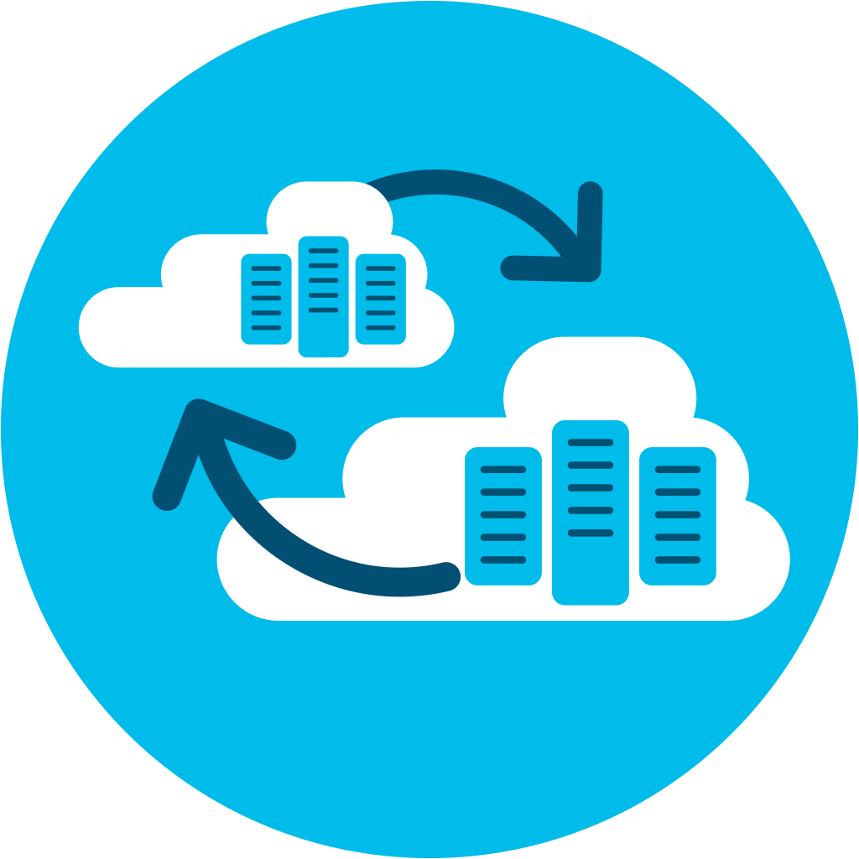
Intent-based networking
Business
Intent
Security
Policy
Assurance
Translation
Comprehensive automation
Context
IT success requires automating the operation and management of your network.
Activation
Intent-based networking
Analytics and assurance
Analytics
Automation
Consistent security
Enterprise+
Campus and branches
Data
centers
Multicloud
Users and things
Applications and services
© 2018 Cisco and/or its affiliates. All rights reserved.

Slide 8

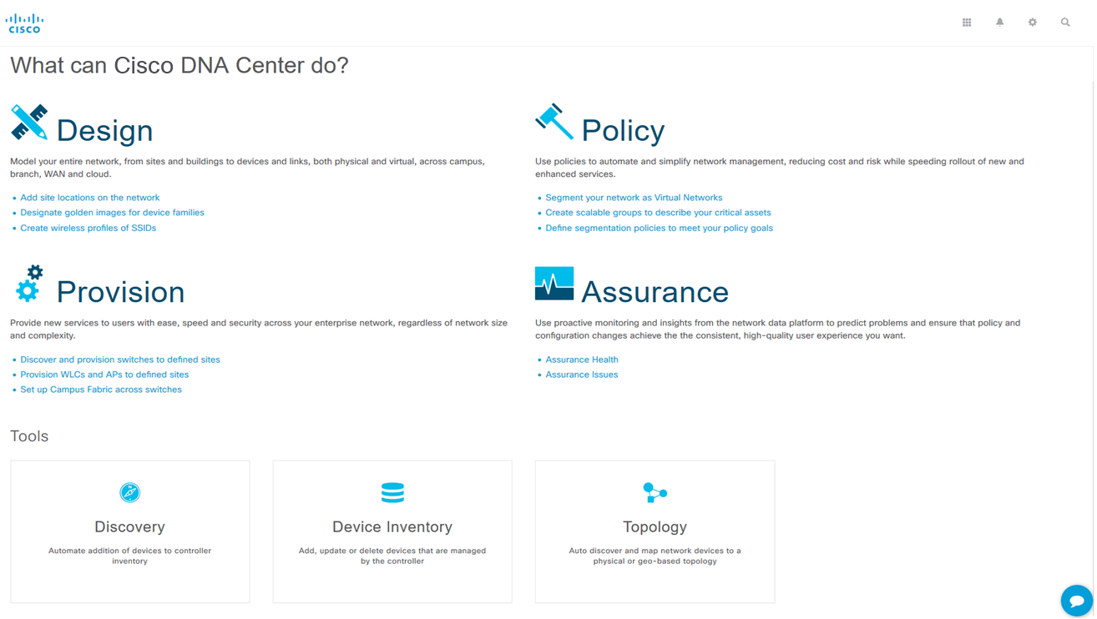

Cisco DNA Center
Command and control center for intent-based networking
Cisco DNA Center
Policy
Provision
Design
Assurance
Cisco DNA Center Appliance
Complete network
management system
  Single pane of glass for all devices
  End-to-end health information in real time
  Granular visibility
  Simplified workflows
Automation for provisioning
  Zero-touch deployment
  Device lifecycle management
  Policy enforcement
Analytics for assurance
  Verify intent of network settings
  Proactively resolve issues
  Reduce time spent troubleshooting
  Platform for extensibility
  Integrate APIs with third-party solutions
  Integrate and customize ServiceNow
  Evolve operational tools and processes
Physical and virtual infrastructure
Cisco and third party

Slide 9
Cisco DNA Center
Comprehensive Automation
Analytics and Assurance
Consistent
Security
Policy, design, provision, integrate platforms
Automate troubleshooting
Guided remediation
Prioritized applications
User-based policies broad system visibility
Automate adds and changes
Increase user productivity
Increase security threat protection

Slide 10

Cisco DNA Center
Delivering real outcomes today…..
67%
Network
provisioning
time savings
80%
Improved issue
resolution
48%
Reduced impact of security
breaches
61%
Lower operating
expense
* Source: Internal TCO analysis with large enterprise customer (actual results may vary)

Slide 11
Cisco DNA Automation
Reduce the time and complexity involved in getting your network
connected and doing what you intended it to do.
Deploy
Manage
Assure
Policy, design, provision, integrate platforms
Software image management, changes, routing, security, compliance
Guided remediation, automated updates, system optimization
Successful IT rollouts
Increase IT productivity
Improve performance

Slide 12

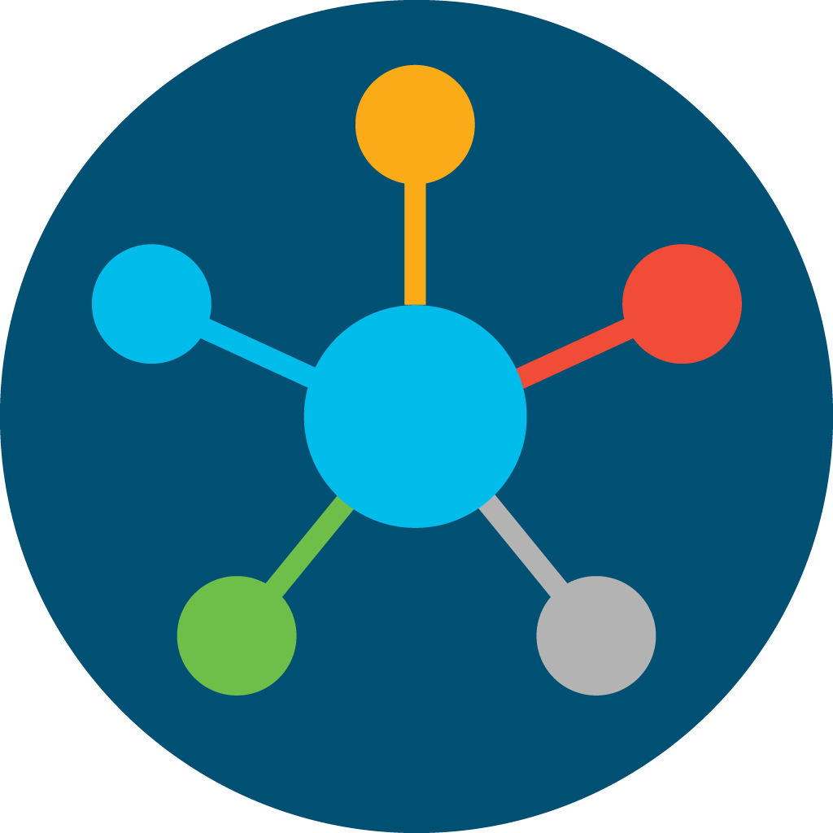


1
Comprehensive automation
How Cisco does it
Policy-based onboarding reduces human error and guarantees uniformity.
Before
After
Manual device configuration
Adds, changes, and upgrades all automated
Zero-touch provisioning speeds and simplifies adding new devices.
Software image management provides consistency for better network performance.
Benefits
Deploy networks in minutes, not days
Ensure consistency in device configuration
Lower cost of network operations
Process integration with ITSM and IPAM further streamlines operations.

Slide 13
Network provisioning simplified
Fast and secure onboarding of devices and users
Before
Employee virtual network
Now
Users
VLAN and IP address based
Create IP-based access control lists for access policy
Deal with policy violations and errors manually
No VLAN or subnet dependency for segmentation and access control
Define one consistent policy
Policy follows identity
Group 1
Group 2
Devices
IoT virtual network
Group 3
Group 4
Drag policy
to apply
Apps
Guest virtual network
Group 5
Group 6
Completely automated
Group-based policy
Policy follows identity

Slide 14
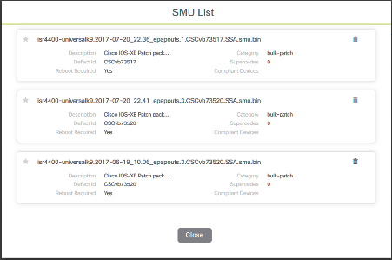
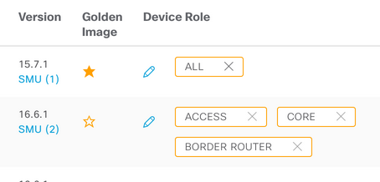
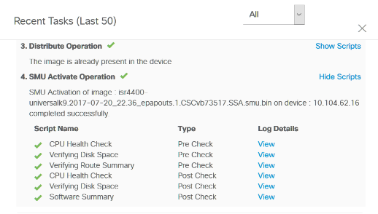
Network changes made easy
1
2
3
Intent-based
network upgrades
Intent-based network upgrades allow for image standardization, much desired by all network admins
Upgrade pre
and post checks
Pre and post checks give network admins more control over and visibility into network upgrades
Patching support
Patches are supported in Cisco DNA Center from intent to pre and post checks in the same way that we manage regular images

Slide 15

Software image management
Request software update
Intent-based network upgrades
Capture your upgrade intent to automate process and drive consistency
Identify golden image
Identify golden image
Post -deployment validations
Select devices
Streamlined upgrade process
Upgrade base image, and install patches and other add-ons in one single flow
Activate software
Create CR
Cisco DNA Center
Trustworthiness integration
Assure that device images are not compromised in any way
Distribute software
Approve CR
Pre-check validations
Patching support
Pre and post checks help ensure that updates do not adversely affect the network
Automate your software upgrade cycle

Slide 16
Network deployment time savings
Policy
6 complex steps reduced to 2 simple clicks
Design
12 find and define tasks now auto-discover and import
Provision
8 manual configuration steps reduced to select and drop
Savings
Workflow time per device:
Before
4 hours
Now
5 minutes
Before
2 hours
Now
15 minutes
Before
5 hours
Now
5 minutes
Before
11 hours
Now
25 minutes

Slide 17
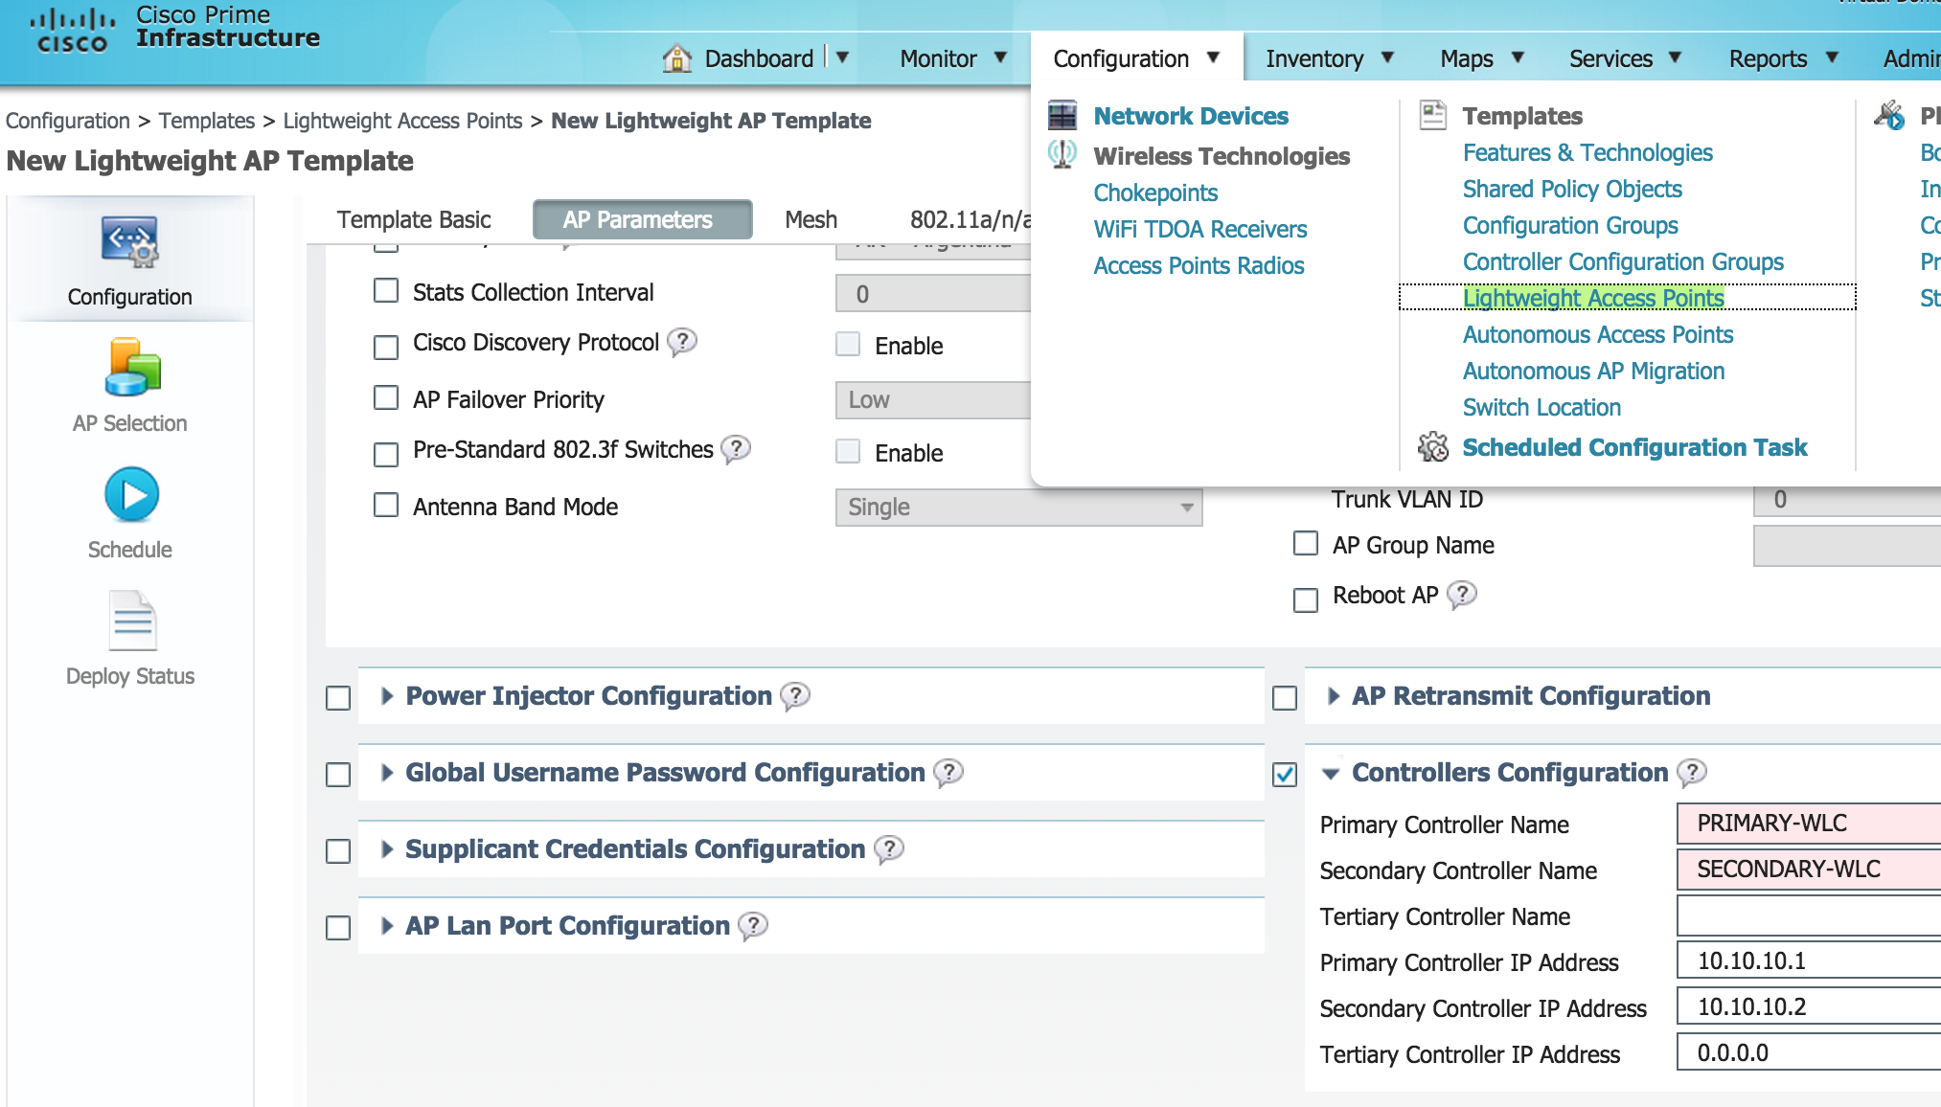
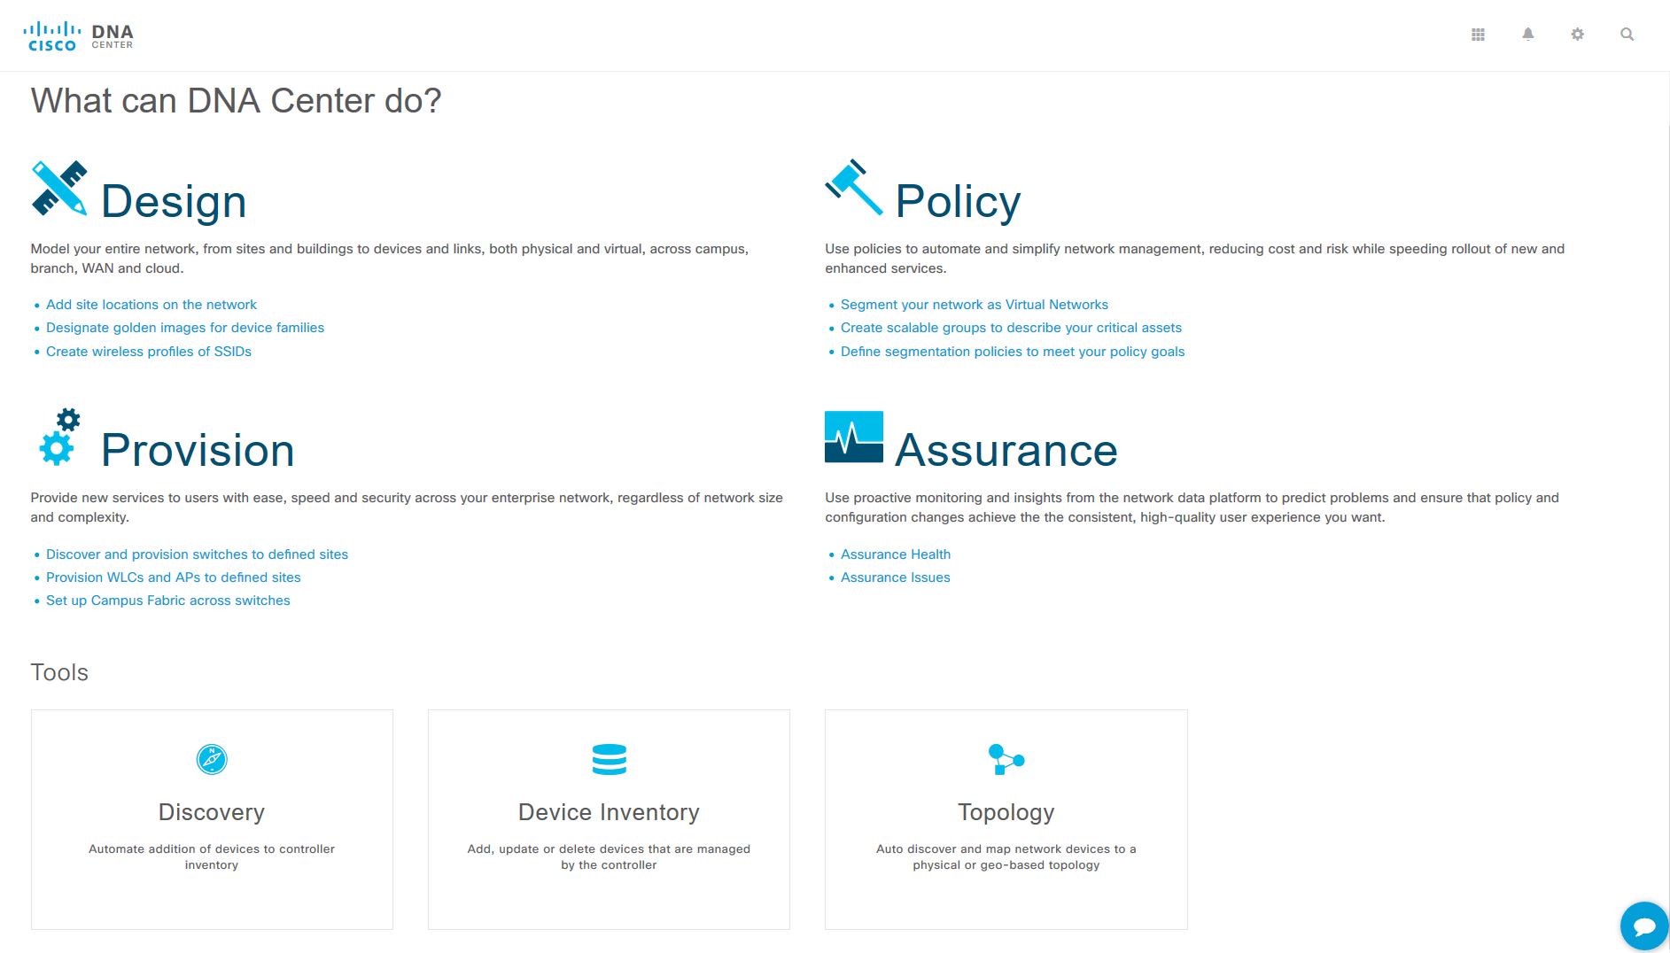
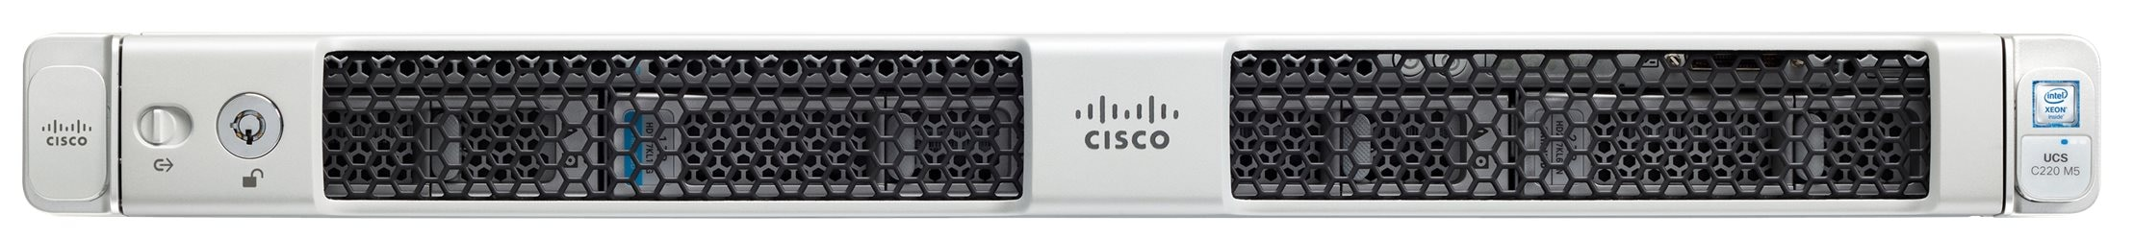
Cisco Prime to Cisco DNA Center migration
Cisco Prime® Infrastructure
Cisco DNA Center
Maps
Topology
Devices
Configurations
Cisco Prime Infrastructure appliance
Cisco DNA Center appliance
Data sharing
Physical and virtual infrastructure
Cisco and third party

Slide 18

Automation case study: Healthcare
For Internal Use Only
“Cisco DNA Center is the only way we can keep up with the explosion of devices on our network.”
Marty Miller, Technology Strategist, Children’s Hospital Los Angeles.
Challenge
Solution
Result
Upgrade aging infrastructure: Install and provision 350 switches and 2000 wireless access points in 25 buildings.
Automate to scale: Allow hospital to grow from 30,000 current connected devices to over 100,000 devices in the next five years.
Use Cisco DNA Center Automation to simplify and secure onboarding of new network devices.
Simplify: Manual processes that complicate onboarding are replaced with plug-and-play simplicity.
Normalize: Policy-driven provisioning guarantees consistency of configurations across large networks.
Manage: Software image management assures security patches, and upgrades are delivered everywhere.
Source: Customer interview

Slide 19
2
How Cisco does it
Analytics and assurance
Streaming telemetry and contextual data from every device on the network provide complete visibility.
Before
After
Hours spent fixing network faults
Resolve issues with a single mouse click
Complex event processing with a series of analytics engines finds anomalies instantly.
Correlated insights and contextual cognitive analytics accurately pinpoint root cause.
Benefits
Automatically detect and prioritize issues
Instant guided remediation for quick resolution
Increased performance and less time spent
Guided remediation allows for single-click resolution, allowing automation to close
the loop.

Slide 20
What is assurance?
The guarantee that the infrastructure
is doing what you intended it to do
Continuous verification
Insights and visibility
Corrective actions
Configurations, changes, routing, security, services, VMs, compliance, audits
Visibility, context, historical insights, prediction
Guided remediation, automated updates, system optimization
Successful IT rollouts
Reduced downtime, increased user productivity
IT productivity

Slide 21

Cisco DNA Assurance
From network data to business insights
Network telemetry
contextual data
Complex event processing
Correlated
insights
Suggested
remediation
Traceroute
Syslog
NetFlow
Complex correlation
Clients
Baseline
AAA
Router
DHCP
Telnet
Wireless
CLI
Metadata
extraction
DNS
Everything as a sensor
OID
IPSLA
Ping
SNMP
IPAM
MIB
Steam Processing
AppD
Application
Network
CMX
Over 150 actionable insights
Clients | Applications | Wireless | Switching | Routing

Slide 22


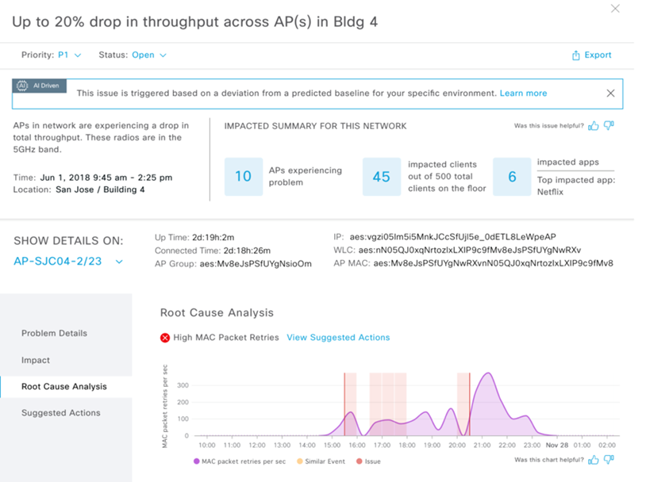
Cisco AI Network Analytics
Machine learning
Visibility: Personalized baselining
Intelligently define personalized ”network normal” using unified global telemetry collected
AI Network Analytics
Insight: Intelligent data analysis
Increase signal to noise, reduce false positives, and accurately identify trends and root causes.
Action: Accelerated remediation
Cisco DNA Center
Create automated resolution options for IT to act
on based on machine reasoning algorithms.

Slide 23

Cisco advantage
Best data, best knowledge base
Diverse data:
Network,
application, security
Syslog
Traceroute
NetFlow
Router
DNS
Worldwide data platform
Anonymized data
Diverse networks:
Local and global
AAA
Your network
CLI
Telnet
DHCP
Wireless
Ping
AI/ML
OID
MIB
Accurate
insights
Streaming telemetry :
Cloud connected
IPSLA
IPAM
SNMP
CMX
AppD
Improved performance
35
years of top
engineering
knowledge
Communities
Knowledge base
Cisco Fellows
CX
TAC
Cisco DNA Center
Distinguished Engineers

Slide 24
Improve incident alert fidelity for each network
Personalized baselining
Collect global telemetry
Before: Custom thresholds = alert overload
Max
Min
AI-driven: Dynamic baselines = relevant anomalies
Cisco DNA Center

Slide 25
Proactive and predictive insights
Intelligent data analysis
Proactive exploration
System-generated insights
Peer-to-peer and
site-to-site comparison
Find issues
before users do

Slide 26


Accelerated remediation
Powered by machine reasoning algorithms
Visibility
Insight
Action
Network
analytics capture
Guided
remediation
Machine
reasoning engine
Automated troubleshooting
and root cause analysis
Close the intent-based loop
Knowledge base
Proactive exploration

Slide 27
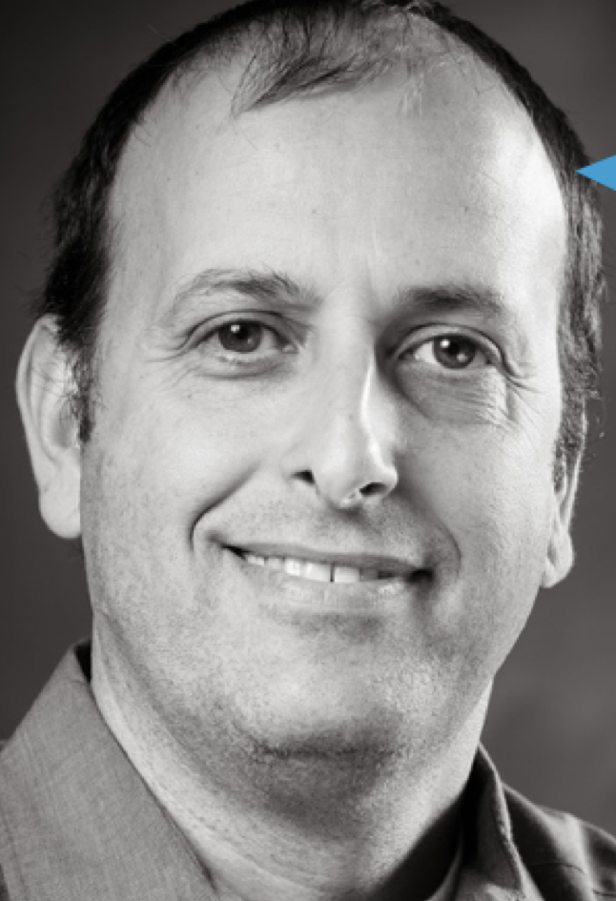





AI/ML customer validation
20 AI/ML early field trials
“AI Network Analytics is like having an owl in my network; it helps me see in the dark.”
“AI Network Analytics helps me isolate onboarding issues and automatically reduce false positives.”
“Cisco AI Network Analytics has enabled us to understand the most important connection and throughput issues across our network.”
Shai Silberman
Director of Network Services
SJSU
Jordi Marin Manzanara
Lead Network Engineer
King Gaming
Joel Bonestell
Network Services Manager
Durham County,
North Carolina

Slide 28
The cost of troubleshooting
Typical troubleshooting issues for an enterprise network with 800 users (wired and wireless)
Issue/task | Cisco DNA Center | Traditional CLI | Savings | Occurrences per week | Hours saved per week | Days saved per year
Traceroute | Instantaneous | 6 minutes | 6 minutes | 25 | 2.5 hours | 15
Slow onboarding | 2 minutes | 17 minutes | 15 minutes | 20 | 5 hours | 30
Device RPA failure | Instantaneous | 20 minutes | 20 minutes | 6 | 2 hours | 12
Radio channel analysis | 5 minutes | 25 minutes | 20 minutes | 6 | 2 hours | 12
Issue replication | 5 minutes | 65 minutes | 60 minutes | 2 | 2 hours | 12
Site visit | Not required | 180 minutes | 180 minutes | 0.5 | 1.5 hours | 9
Total: |  |  |  |  | 15 hours | 90
90
What would you do with 90 extra productive days per year?

Slide 29
Use case 1: Client onboarding is taking a long time
Before Cisco DNA Center
After Cisco DNA Center
Time to resolve issue in minutes
User reports problem
10
Check credentials
17
Replicate issue
117 min
65
5 min
Radio channel analysis
25
5
Impact/downtime to network user is identical
Success
metrics
Proactively find slow on-boarding before users report
Reduce the time taken
to resolve issues
Reduce troubleshooting time with advanced tools

Slide 30
Use case 2: Client is having a poor app experience
Before Cisco DNA Center
After Cisco DNA Center
Time to resolve issue in minutes
User reports problem
10
Check for RPA failure
20
Run traceroute
156 min
6
10 min
Site visit
120
Aironet® Active Sensor
10
Impact/downtime to network user is identical
Success
metrics
Client performance summary
on main page
Reduce the time taken
to resolve issues
Reduce troubleshooting OpEx
by solving remotely

Slide 31
Use case 3: Client is having a poor wireless experience
Before Cisco DNA Center
After Cisco DNA Center
Time to resolve issue in minutes
5
Radio channel analysis
25
Replicate issue
65
Site visit
210 min
120
20 min
Cisco DNA Center time travel
5
Aironet® Active Sensor
10
Impact/downtime to network user is identical
Success
metrics
iOS client insights provide immediate information
Save time replicating issues
with time travel feature
Reduce troubleshooting OpEx
by solving remotely

Slide 32

Assurance case study: Finance
“The more intuitive we can make troubleshooting for the team, the sooner we can can take the network out of the equation.”
Nicholas Yurkovich, Chief Network Engineer, Scotiabank
Challenge
Solution
Result
All wireless network – no time for downtime: Scotiabank embraced wireless networking as the primary mode of network access; 25,000 square feet of wireless-only space, is expected to grow to 1 million square feet in 2 years.
Use Cisco DNA Assurance to centralize management of all
network functions for Scotiabank’s 3000+ global branches, 100+ offices, 88,000+ employees, and 290,000+ intellectual property
assets worldwide.
Simplified troubleshooting: Simple to see when and where issues arise.
Independent and proactive approach: The first-line support teams can now handle the more rudimentary problems, while the Level 3 and engineering networking teams can work on growth and forward-looking opportunities.
Source: Cisco Newsroom

Slide 33


3
Consistent security
How Cisco does it
Cisco® Identity Services Engine enforces policies and compliance while simplifying user access.
Before
After
Always chasing new threats
Continuous monitoring and compliance
Network security analytics uses multilayered machine learning to detect advanced persistent threats.
Cisco Stealthwatch® monitors streaming telemetry to instantly detect zero-day malware.
Benefits
Fast and accurate policy compliance auditing
Minimized operational or security risks
Security posture hardened by 35%
Encrypted Traffic Analytics identifies security threats within encrypted data.

Slide 34

Cisco enterprise network security
Visibility
“See everything”
Complete visibility into users, devices, threats, networks, applications, workloads, and processes
Segmentation
“Reduce the attack surface”
Prevent attackers from
moving laterally through
role-based segmentation
Threat protection
“Stop the breach”
Quickly detect and respond to threats before hackers can steal data or disrupt operations

Slide 35
Access Control Application (ACA)
Improves access control policy user experience in Cisco
DNA Center
Facilitates SD-Access micro-segmentation
Enables SD-Access adoption for customers using third-party RADIUS
Speeds deployment of
SD-Access
C
B
Edge1
Edge3
LightingSGT
CamerasSGT
EmployeeSGT
DeveloperSGT
ContractorSGT
SupplierSGT
IoT VN
Corporate VN

Slide 36
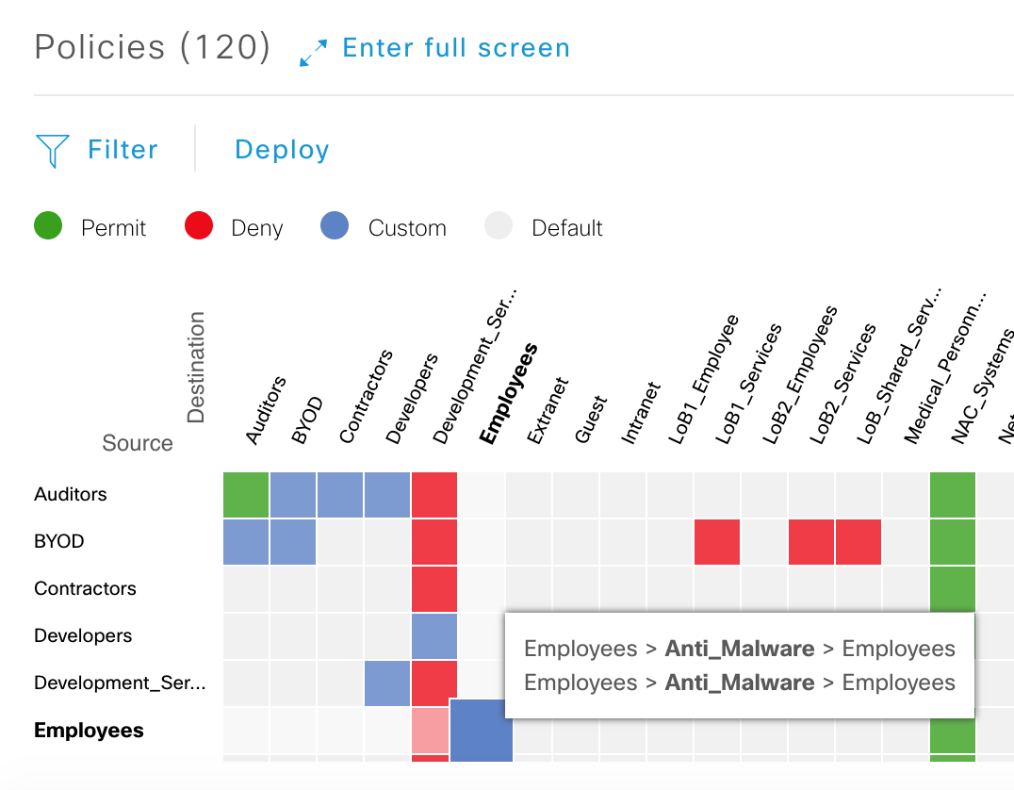
Access Control Application
Door locks
Account
manager
Cameras
Loan agent
Point of sale
Financial analyst
Billing
HR
Internet
Clients
Guest
Client records

Slide 37
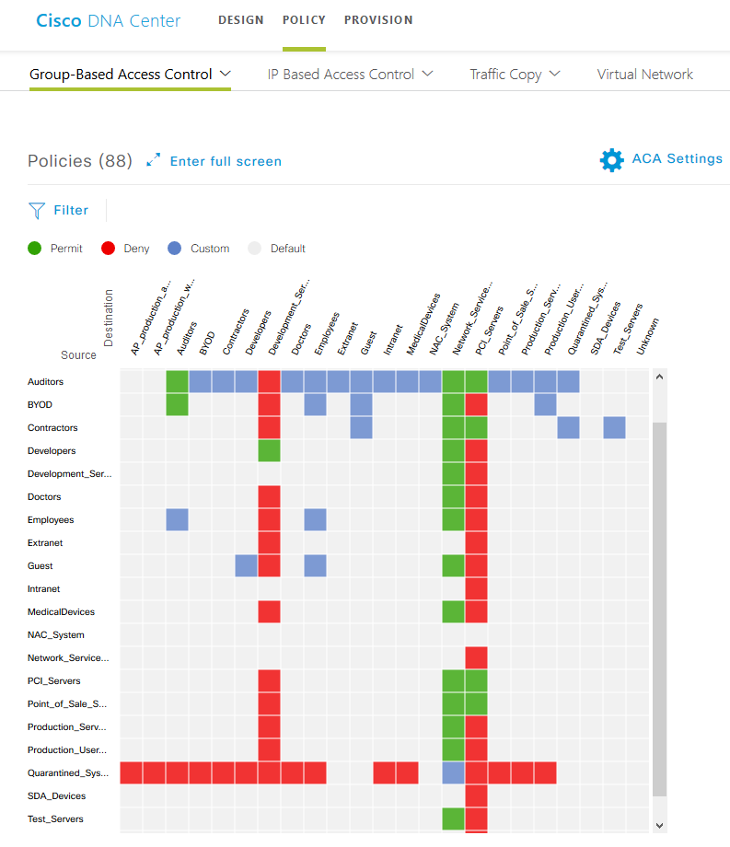
Applying policy
Security group tags (SGTs)
Employee SGT (5)
10.1.100.1
Employee SGT (5)
10.2.200.6

Slide 38
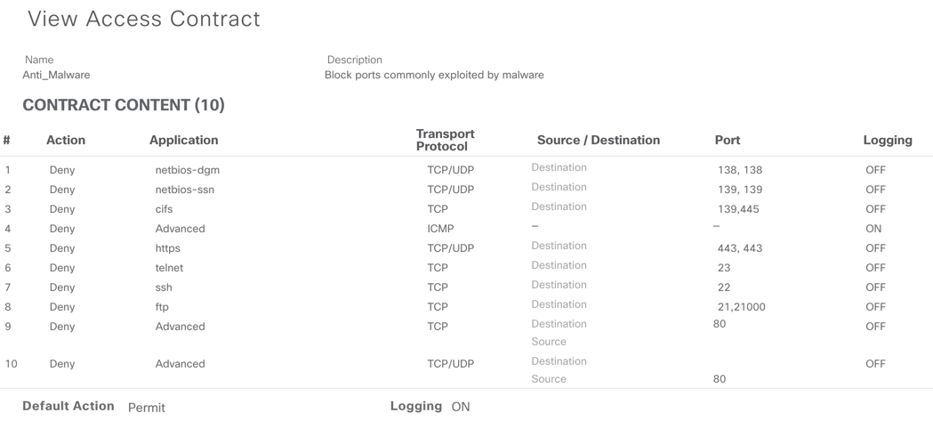
Restricting lateral movement
Security group tags (SGTs)
Suspicious SGT (6)
10.1.100.1
Employee SGT (5)
10.2.200.6

Slide 39


Isolating potentially compromised hosts
Business data
app/storage
SG-Firewall
Source |  | Destination |  |  | Action
IP | SGT | IP | SGT | Service | Action
Any | Employee | Any | Biz Server | HTTPS | Allow
Any | Suspicious | Any | Biz Server | Any | Deny
NIDS
SIM
Event: reconnaissance
Source IP: 10.10.10.10/32
Response: Quarantine
pxGrid: ANC quarantine: 10.10.10.10
Corporate
network
Source IP: 10.10.10.10/32
MAC address: aa:bb:cc:dd:ee:ff
Policy mapping → SGT: Quarantine
SGACL
Switch#show cts role-based permissions
IPv4 Role-based permissions from group 255:Quarantined to group 4:Employees:
Deny IP-00
Employee

Slide 40
Stealthwatch Encrypted Traffic Analytics
Telemetry exporter*
Cisco Stealthwatch®
NetFlow
Machine learning
Malware detection and cryptographic compliance
Telemetry for
encrypted malware detection
and cryptographic compliance
Metadata
Enhanced NetFlow
Industry’s first network with the ability to find threats in encrypted traffic without decryption
Avoid, stop, or mitigate threats faster then ever before | Real-time flow analysis for better visibility
* Cisco® Catalyst®, ISR, ASR, CSR are supported

Slide 41
Automating NetFlow for ETA
NetFlow provides
A trace of every conversation in your network
An ability to collect records everywhere in your network
(switch, router, or firewall)
Network usage measurements
An ability to find north-south as well as east-west communication
Indications of Compromise (IOC)
Security group information
Cisco DNA Center
Flow Information | Packets
SOURCE ADDRESS | 10.1.8.3
DESTINATION ADDRESS | 172.168.134.2
SOURCE PORT | 47321
DESTINATION PORT | 443
INTERFACE | Gi0/0/0
IP TOS | 0x00
IP PROTOCOL | 6
NEXT HOP | 172.168.25.1
TCP FLAGS | 0x1A
SOURCE SGT | 100
: | :
APPLICATION NAME | NBAR SECURE-HTTP
ETA NetFlow Configuration
NetFlow
Telemetry for
encrypted malware
detection
and cryptographic compliance
Cisco DNA Center appliance
Physical and virtual infrastructure
Cisco and third party

Slide 42




Rapid threat containment using Cisco DNA Center
Closed-loop security incident flow
Stealthwatch®
Centralized device management
Configure network devices to send telemetry for security analytics, including encrypted traffic
Policy
Assurance
Automation
Real-time threat monitoring
Cisco DNA Center
View critical threats detected using machine learning and global threat intelligence
Platform
Streamlined security workflow
Share incident information with integrated IT service management (ITSM) so that IT ops can take action
Faster threat mitigation
Quarantine the user from the network to prevent threat propagation

Slide 43

Security case study: Healthcare
“Using identity to dynamically adjust security
policy has been a big win for us.”
Tyler Palmer, Network Architect, Lawrence Memorial Hospital, Lawrence, KS
Challenge
Solution
Result
Lack of visibility: Unable to see security threats before they proliferate into the network.
Lack of user policy enforcement: User access control limited to basic password to assets.
Need to comply with PCI DSS: Payment system required increased digital security.
Use Cisco® ISE and network security analytics to define policies and centralize network security.
Better visibility: Easily detect devices throughout the network and identify users.
Policy compliance: Enforce network policies on a per-user basis, consistently and without exceptions.
Detect and contain threats: Find anomalies in data security and segment threats before users
are affected.
Source: Cisco Newsroom

Slide 44
Cisco DNA Center platform
Open platform
Partner ecosystem
Developer enablement
API catalog
Third-party SDK
Process adapters
Partner integrated solutions
Developer’s DevNet portal

Slide 45



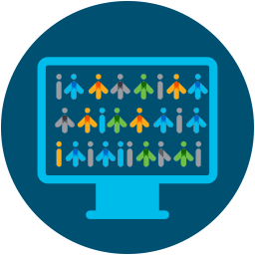

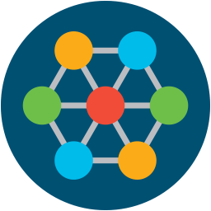
Cisco DNA Center platform: 360-degree extensibility
Business and IT efficiency
Third-party
network/IT systems
Cross-domain
integration
1
IPAM
Policy
DC
Security
ITSM
Apps
Physical and virtual infrastructure
Cisco and third party

Slide 46
Cisco DNA licensing
Cisco DNA Premier
Stealthwatch with ETA
ISE: Identity Services Engine
Cisco DNA Spaces
Advanced security
Advanced policy control
Wireless location analytics
Cisco DNA Advantage
Cisco AI Network Analytics
Cisco DNA Assurance
Cisco SD-Access
AI/ML analytics, assurance
Multidomain integration
Fabric automation
Cisco DNA Center
Cisco DNA Essentials
Cisco DNA Automation
Prime Infrastructure Migration
Cisco DNA Center
Base automation
Network management system

Slide 47


Transformation requires changes to how work is done
The Cisco Customer Experience team can help
Technology
People
Process
Accelerate adoption
Build in-house expertise
Simplify operations

Slide 48





Services portfolio for Cisco DNA Center
Advisory
Implementation
Optimization
Managed
Technical
Training
Cisco DNA Advisory
Cisco DNA Strategy and Analysis
Cisco DNA Assessment
Cisco DNA Center Advise and Implement
Cisco DNA Center Advise and Implement Quick Start
Business Critical Services for Cisco DNA
Managed Enterprise Networks
Solution Support
Smart Net Total Care®
Getting Started with Cisco DNA Assurance
Cisco DNA Implementation Essentials
Accelerating your Cisco DNA journey

Slide 49

Start navigating your digital network journey today
Cisco Digital Network Architecture
  Next steps
Ask for a demo of Cisco DNA Center
Request a free network readiness assessment or ROI analysis
Let us help you pilot Cisco DNA Center
Assurance in a lab

Slide 51






Cisco DNA Center: Easy to start with Assurance
Intent-based networking
Cisco DNA Center
Cisco® Software-Defined Access
Cisco DNA Center security
Cisco DNA Center Assurance
Telemetry protocols:
NetFlow, SNMP, Syslog, streaming
CLI, SNMP, PnP, NETCONF
Wireless access point
Cisco® Catalyst® 2000, 3000
Cisco Catalyst 4000, 6000
Cisco Nexus® 7000
Wireless controller
ISR/ASR
Wireless
802.11ac
Wave 2 AP
Cisco
Catalyst 3850
Cisco
Catalyst 9000
Industrial Ethernet Catalyst
Wireless controller
4000 Series ISR
NFV-IS
Traditional Cisco and third-party networks
Cisco DNA ready networks

Slide 52


Leverage and analyze data from every point on the network
Routers
Switches
Wireless
controllers
Network and application performance
Guided remediation for quick issue resolution
AAA
DDI
DHCP
NetFlow
Syslog
Policy
Network sensors and iOS analytics
Network time travel
Devices
Sensors
Now your network can deliver more business benefits

Slide 53
Network time travel
Network health score
9/10
Client health score
Issues:
Go back in time and investigate: The dual-band-capable client is preferring 2.4 GHz over 5 GHz.
Look at “Suggested Actions” from noon to fix the issue from
the past.
Sensor-driven test: Proactively schedule a test with Aironet® Active Sensor to help ensure a great user experience.
SJC08-1 WAN will be oversubscribed.
Look at “Suggested Actions” now to prevent the issue from happening.
10/10
Issues and trends
-24 hours
- 3 hours
Now
+ 3 hours
+24 hours
No need to replicate issues; just go back and see exactly what happened.

Slide 54






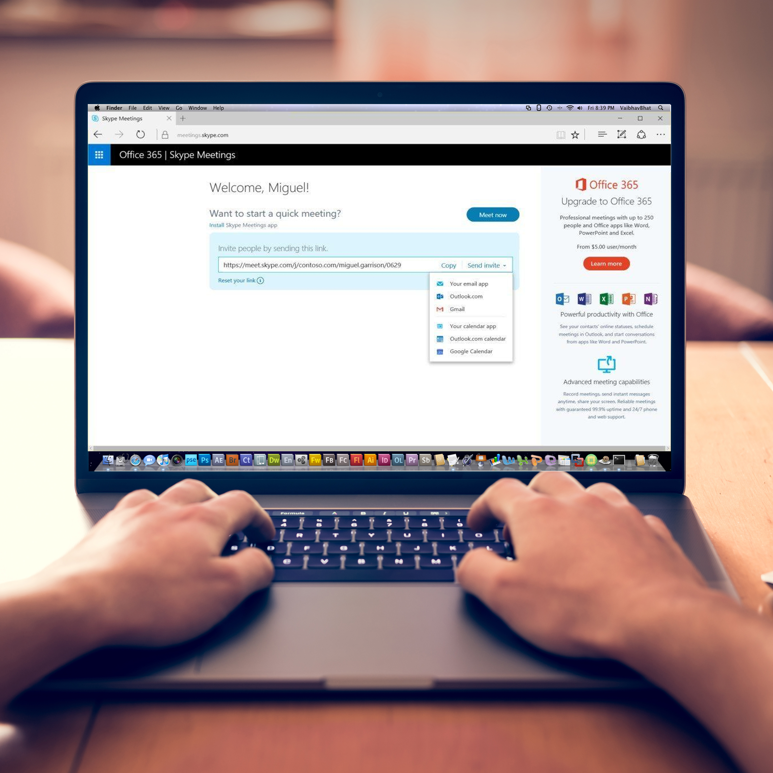
Aironet Active Sensors
Use a powerful network-testing solution endpoint to put yourself anywhere in your network.
Cisco’s network sensors allow you to see the actual performance of applications and services from a user’s point of view.
IT

Slide 55
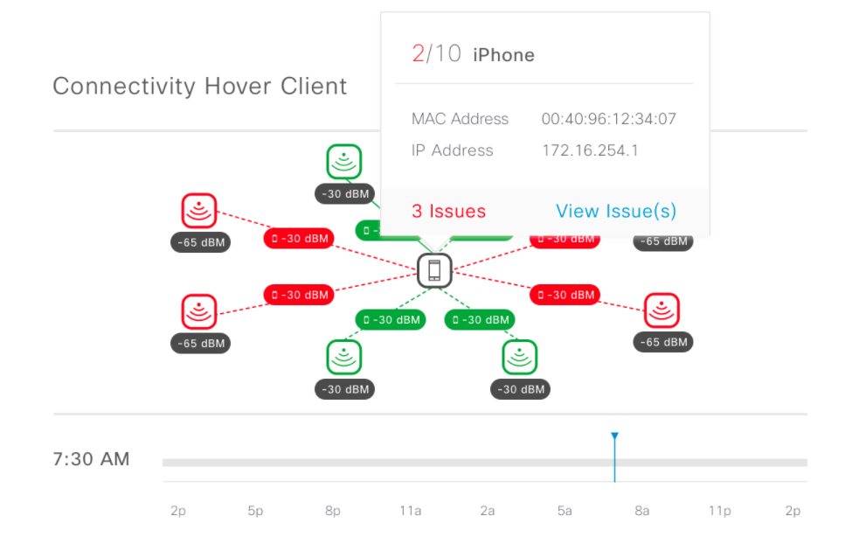
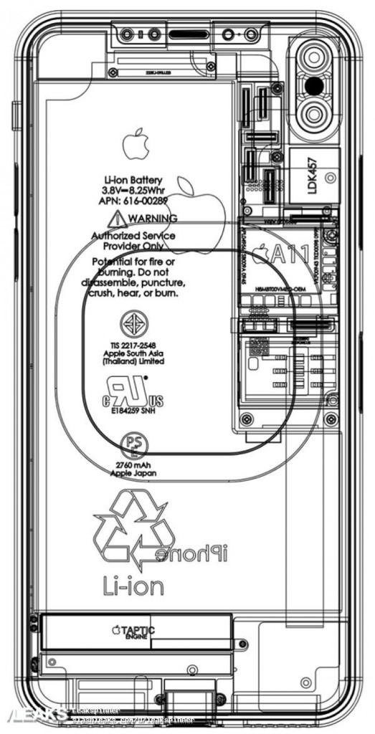

Wireless client insights
Apple
and
Wi-Fi analytics for iOS
This partnership with Apple enables any iOS 11 client to speak to Cisco DNA Center with client diagnostics.
Provides a more comprehensive view of all potential root causes of wireless issues.
Problems affecting iOS clients are likely affecting all
wireless clients.
Device profile
Client shares these details
Model: iPhone 7
OS: iOS 11.2
Wi-Fi analytics
Client shares these details
BSSID
RSSI
Channel number
Assurance
iOS client shares the reason (error code) for the disconnect.
1
2
3
Support per-device-group policies and analytics
Insights into the client’s view of the network
Clarity into the reliability of connectivity

Slide 56
Predict performance in wireless
Data telemetry and assurance enhance Cisco CleanAir® and
Flexible Radio Assignment wireless network technologies, providing improved wireless performance in challenging deployments:
Interference detected
Interference detected
Available channels
Access point
Open office environments
Offices with large windows
Switching channels
Operational channel
Switching channels
Switching channels
Offices in large buildings
or on a campus
Interference detected
Listen for better wireless performance

